Slide 1
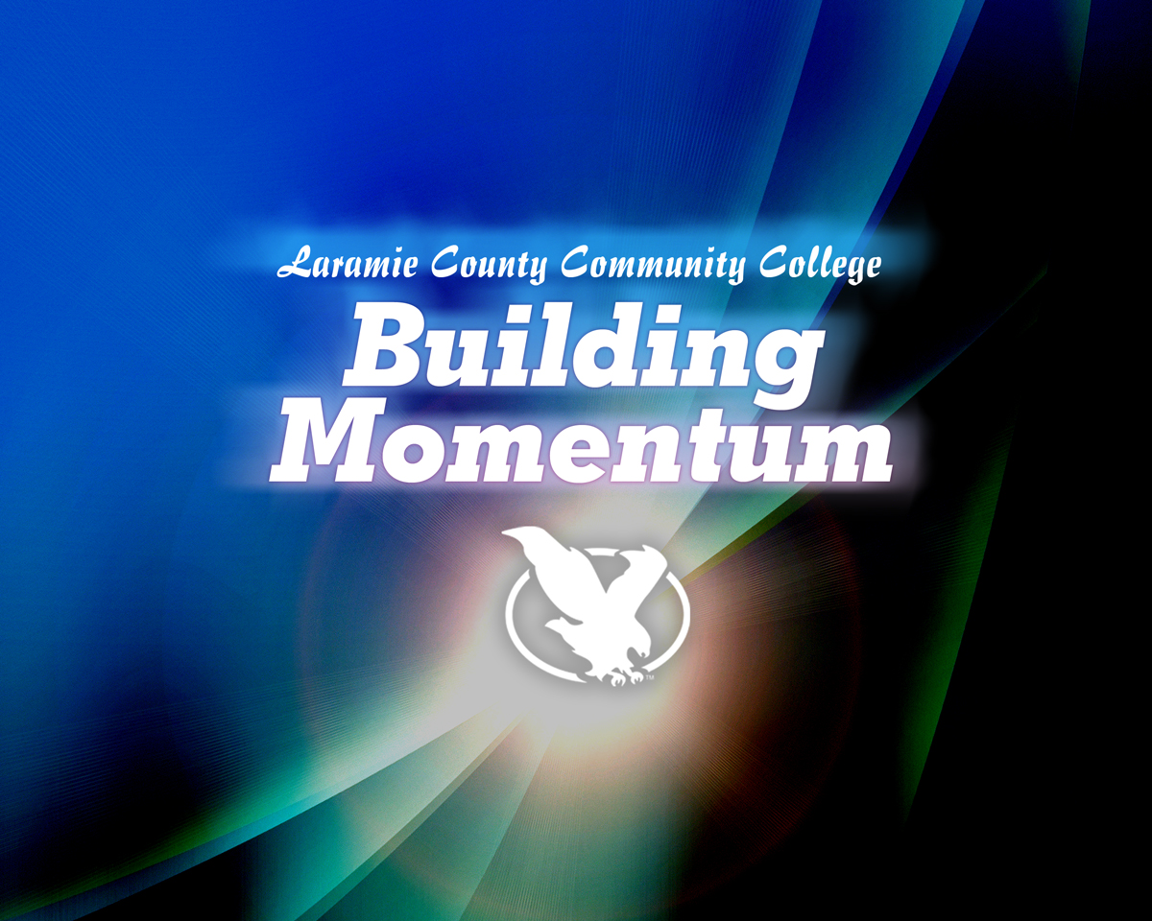
Fall 2012 State of the College Address
August 15, 2012

Slide 2

Recap of the Past Seven Months
Emphasis has focused on:
Meeting, Listening and Learning
Getting the Right People in the Right Places
Planning for Expanded and Improved Facilities
Institutional Stability

Slide 3
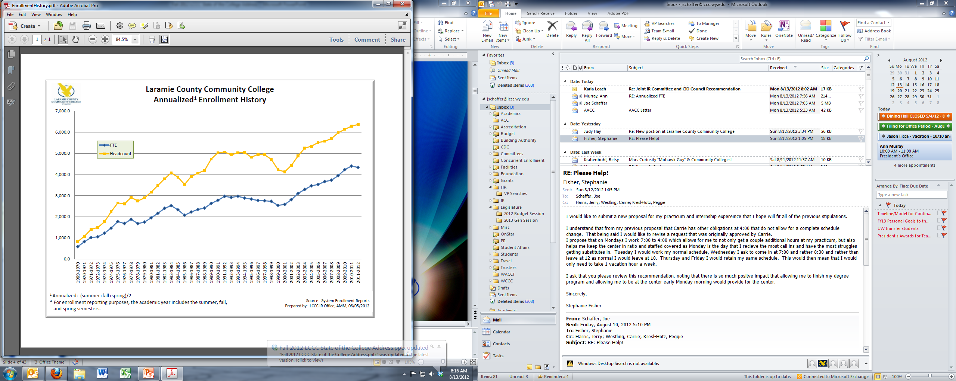
Enrollment

Slide 4
Enrollment

Slide 5
Enrollment

Slide 6
Enrollment
 | Fall 2012 Enrollment Data
 | Four weeks before class start | Point-to-Point Report for monitoring purposes only
 |  | Fall 11 | Fall 12
 |  | 5-Aug-11 | 3-Aug-12 | Difference | %Change
 | Student Enrollment Level
 | Full-Time | 2071 | 1893 | -178 | -8.6%
 | Part-Time | 1937 | 2013 | 76 | 3.9%
 | Student Program Type
 | Academic Transfer | 1931 | 1768 | -163 | -8.4%
 | Occupational Technical | 1270 | 1315 | 45 | 3.5%
 | Undeclared | 807 | 823 | 16 | 2.0%
 | Enrollment By Age |  |  | Difference | % Change
 | Traditional (< 24) | 2057 | 1972 | -85 | -4.1%
 | Adult (25 & Over) | 1948 | 1930 | -18 | -0.9%

Slide 7
Budget: Funding
& Spending
Wyoming Continues to Invest in Community Colleges!
LCCC: $31.5 Million in FY13

Slide 8
Budget: Funding & Spending
Source: Wyoming Community College Commission

Slide 9
Budget: Funding & Spending
Source: Wyoming Community College Commission

Slide 10
Budget: Funding & Spending
Source: Wyoming Community College Commission
Source: Wyoming Community College Commission

Slide 11
Budget: Funding & Spending
Source: NCES IPEDS 2011 Data Feedback Report

Slide 12
Budget: Funding & Spending
Source: Wyoming Community College Commission

Slide 13
Budget: Funding & Spending
FY13 Investments
  Instruction
    $897,000 Investment
    $500,00 in Full-Time Faculty
    6.2% increase from FY12
  Institutional Support
    $171,000 in Human Resources
    $175,000 for Facilities Planning
    $300,000 to Strengthen Foundation
    9.5% Increase from FY12
  Flexibility for Budget Cuts
    $426,000 in Operating Reserve
    $663,000 in One-Time-Only Spending
Source: LCCC FY13 Annual Budget

Slide 14
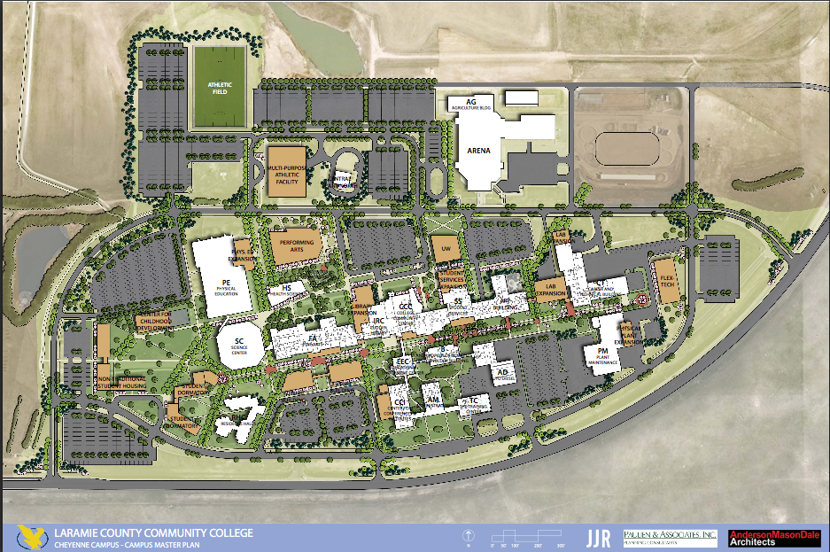
Facilities
Campus Master Plan: Significant Space
Deficiencies at LCCC
  Cheyenne Campus (10% Enrollment Growth through 2020)
    Need an additional 155,722 Gross Square Feet (GSF)
    Current Need = 40,000 GSF
    44,672 GSF for Academic Space
    29,118 GSF for Academic Support Space
    81,931 GSF of Auxiliary Space
    Greatest needs areas: Assembly & Exhibit, Office, Student Center, PE/Rec/Athletics, Housing
  Albany County Campus (10% Enrollment Growth through 2020)
    Need an additional 54,125 GSF; Current Need = 17,000 GSF
    16,000 GSF for Academic Space
    3,550 GSF for Academic Support
    2,320 GSF of Auxiliary Space
    Greatest needs areas: Classrooms & Service, Teaching Labs, Offices, Library, Physical Plant, Student Center
Source: LCCC Campus Master Plan

Slide 15
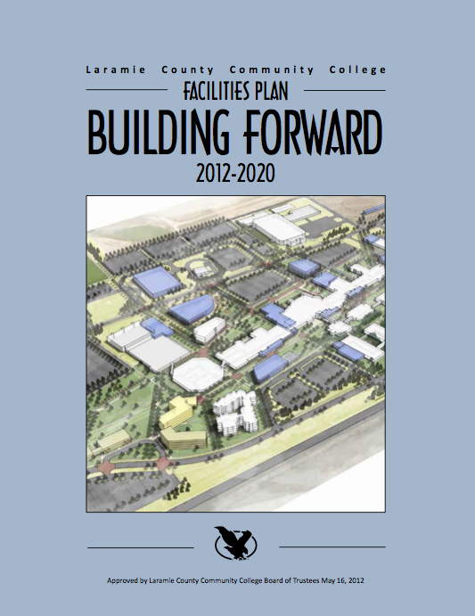
Facilities
“Building Forward” Aggressive Eight-Year Facilities Plan
  University/Student Center
  Flex Tech Building
  Residence Halls
  Performing and Fine Arts Building
  Albany County Campus Expansion @ UW
  Campus Face-Lift

Slide 16
Student Success
Developmental Education, Success and Persistence
Source: Colleague Records, LCCC IR Office 8/8/2012

Slide 17
Student Success
*Calculated using Fall 2008, Fall 2009, Fall 2010 Cohorts only due to time necessary to complete two years of coursework.
**Calculated using Fall 2008, and Fall 2009 Cohorts only due to time necessary to complete.
Progression and Completion
Source: Colleague Records, LCCC IR Office 8/8/2012

Slide 18
Student Success
*Calculated using Fall 2008 and Fall 2009 Cohorts only due to time necessary to complete.
Persistence & Completion by Program Type
Source: Colleague Records, LCCC IR Office 8/8/2012

Slide 19
Student Success
Getting from Undeclared to Declared, ASAP
  The sooner students choose a program of study, the more likely they are to persist to goal attainment (Jenkins 2011).
Source: Colleague Records, LCCC IR Office 8/8/2012
Jenkins, D. (2011). Get with the program: Accelerating community college students’ entry into and completion of programs of study (CCRC Working Paper No. 32). New York, NY: Columbia University, Teachers College, Community College Research Center.

Slide 20
Student Success
At the Foundational Level – the Classroom
Source: Colleague Records, LCCC IR Office 8/8/2012
*National Community College Benchmark Project median (2009 median as floor; i.e., 105% X 74.13% = 77.84%)

Slide 21

Institutional Transformation
The Baldrige Criteria for Performance Excellence
in Education*
  Leadership
  Strategic Planning
  Customer Focus
  Measurement, Analysis, and Knowledge Management
  Workforce Focus
  Operations Focus
  Results
* Available at: http://www.nist.gov/baldrige/publications/education_criteria.cfm

Slide 22
Institutional Transformation
Winning by Degree’s Essential Elements of High Performance Institutions of Higher Education*
  Efficient and effective operational processes supported by appropriate technology and tools.
  Effective management systems to ensure progress, build capabilities, and manage implementation.
  Leaders and staff who are committed to achieving degree productivity gains alongside high-quality educational outcomes.
  Support from state and institutional policies that allow them to choose how to achieve their quality and efficiency goals.
*Auguste, B. G., Cota, A., Jayaram, K., and Laboissière, M. C. A. (2010).
Winning by degrees: The strategies of highly productive higher education institutions.
New York, NY: McKinsey & Company.

Slide 23

Institutional Transformation
Achieving the Dream’s Principles of Institutional Effectiveness*
  Committed Leadership - Senior college leaders actively support efforts to improve student success, not just to increase enrollments
  Use of Evidence to Improve Programs and Services
  Broad Engagement - Faculty, student services staff, and administrators share responsibility for student success.
  Systemic Institutional Improvement - The college establishes planning processes that rely on data to set goals for student success and then uses the data to measure goal attainment
* Available at: http://www.achievingthedream.org/institutional_change/four_principles

Slide 24
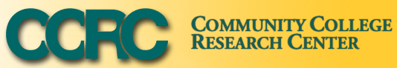
Institutional Transformation
CCRC’s Practices of Effective
Organizations*
  Leadership – committed to improving outcomes
  Focus on the Customer
  Functional Alignment – “Instructional Program Coherence”
  Process Improvement
  Use of Measurement
  Employee Involvement & Professional Development
  External Linkages
*Jenkins, D. (2011). Redesigning community colleges for completion: Lessons from research on high-performance organizations. New York, NY:
Columbia University, Teachers College, Community College Research Center.

Slide 25
Institutional Transformation
Commonality across these:
  Strong, committed leadership focused on outcomes
  Strong “customer focus” – centered on the student
  Emphasis on our workforce, through professional development and broad-based inclusion
  Effective and efficient organizational processes (e.g., planning & assessment)
  Commitment to setting goals
  Using data and measurement to evaluate progress and inform decisions

Slide 26
Institutional Transformation
Progress at LCCC
  Reorganization Starting with the Leadership
  Building Inclusiveness through Shared Governance
  Defining and Measuring Institutional Performance (KPI’s)
  Change in Board Governance = Strengthened Policies & Procedures
  Much more to come…

Slide 27
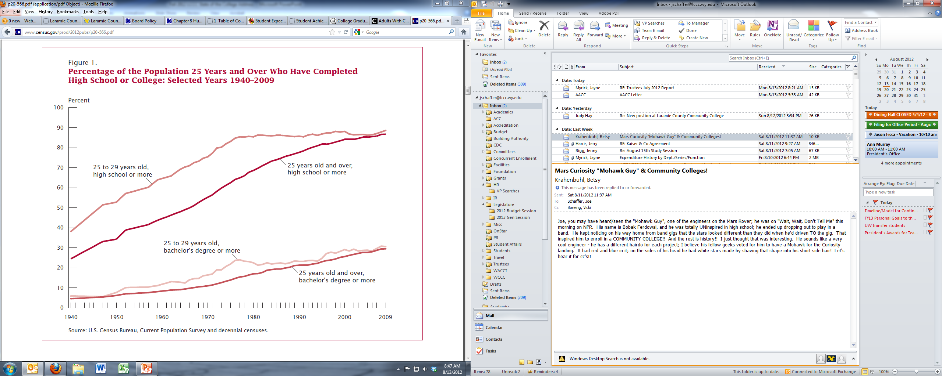
The Completion Agenda
Resolving the Discourse
  It isn’t that the US is doing so much worse, just that other countries are doing so much better…
  Increase has happened as a result of improved access; completion rates have slipped, while time to degree and costs have increased.

Slide 28
The Completion Agenda
Resolving the Discourse
  Completion is not a bad word. Earning a degree or certificate is still the primary reason students go to college.
    96% of Community College students expect to earn an Associate’s Degree or Higher (U.S. Department of Education’s Beginning Postsecondary Students Longitudinal Study 1996-2001).
    79% of Community College students indicate their goal for attending is to earn an associate degree (Center for Community College Student Engagement’s A Matter of Degrees 2012; 2010 SENSE Cohort Data, n=70,138).
  It’s Completion AND Quality, Not Completion versus Quality
    We must keep the quality and rigor within our academic offerings.
    However, we must find new ways to support students in the learning process.

Slide 29
The Completion Agenda
Distilling the Noise
  Complete College America, Achieving the Dream, Access to Success, Lumina, CCSSE, WICHE, ACE, Completion Arch, American Graduation Initiative, etc….
  Common Elements
    Assess Student Learning - Instructional Effectiveness, Course Redesign and Enhancement
    Reform Developmental Education and Placement Assessment
    Align Curricula and Construct Coherent Pathways to Credentials and Transfer
    Integrate Student Services and Strengthen Non-Academic Supports
    Remove Barriers, Simplify Structures, and Improve Policy and Procedures (Colleges & Students)
    Incentivize and Monitor Progress and Completion (Colleges & Students)
    Collect and Use Data to Monitor Progress and Inform Continuous Improvement Processes
    Develop and Engage the Faculty and Staff Collaboratively to Tackle Change

Slide 30
Building Momentum
Focusing on Academic Excellence
  Design & Implement a Framework for Assessing Student Learning: At the course, program, and institution levels.
  Re-examine and Refine our General Education Core: Tied to institutional learning outcomes and recognized by a credential.
  Improve Overall Student Success in Coursework: Focus first on the courses with the lowest success rates.
  Strengthen and Expand Programming through Innovation and Responsiveness to Community and Student Needs: Flexible scheduling, coherent pathways, and utilization of different delivery modalities.
  Develop the Faculty: Establish a center for teaching and learning, focusing on new faculty development and ongoing instructional improvement.
  Empower the Faculty: Place the authority and responsibility over the Academy and our curricula more strongly in Faculty hands.

Slide 31
Building Momentum
Services and Programs to Serve Our Students
  Establish a Centralized, Holistic Model for Student Advising: Advising needs to be much more than course planning.
  Create Early Connections for Students Through Mandatory Engagement: “Students don’t do optional” (Kay McClenney, CCCSE).
    Mandatory New Student Orientation w/Registration
    Mandatory Student Success Course/Freshman Seminar for All Incoming Students
  Improve the “Front Door Experience” at LCCC: Efficient, accurate information focused on the student.
  Plan for the Implementation of Integrated Services and a Student Services “One Stop.”
  Strengthen Student Engagement: Expand opportunities for student involvement outside of the classroom.

Slide 32
Building Momentum
Stabilize and Strengthen the College
  Bolster Shared Governance Through Effective Operations:
    Establish integrated models for institutional planning and an improved budget process, driven by an open and honest assessment of institutional efficacy.
    Process map major organizational processes to identify areas for improvement in campus involvement and process effectiveness.
  Assist the Board in Changes in Governance Model: Trustee’s Governance and Policy = Our Procedures.
  Engage the Campus and Community in Aggressively Pursuing Our Facilities Plan: To meet our needs will require the support of all.
  Match Form to Function Through the Next Phases of Reorganization.
  Establish a Strong, Centralized Human Resources Structure.
  Seek Out Efficiencies Across the Institution.
    Objective and actionable program review
    Examine student fee structure and financial subsidy strategy

Slide 33
What is the State of LCCC?
LCCC is Building Momentum and Poised for a Great Year and an Even Greater Future!

Slide 34


