Slide 1
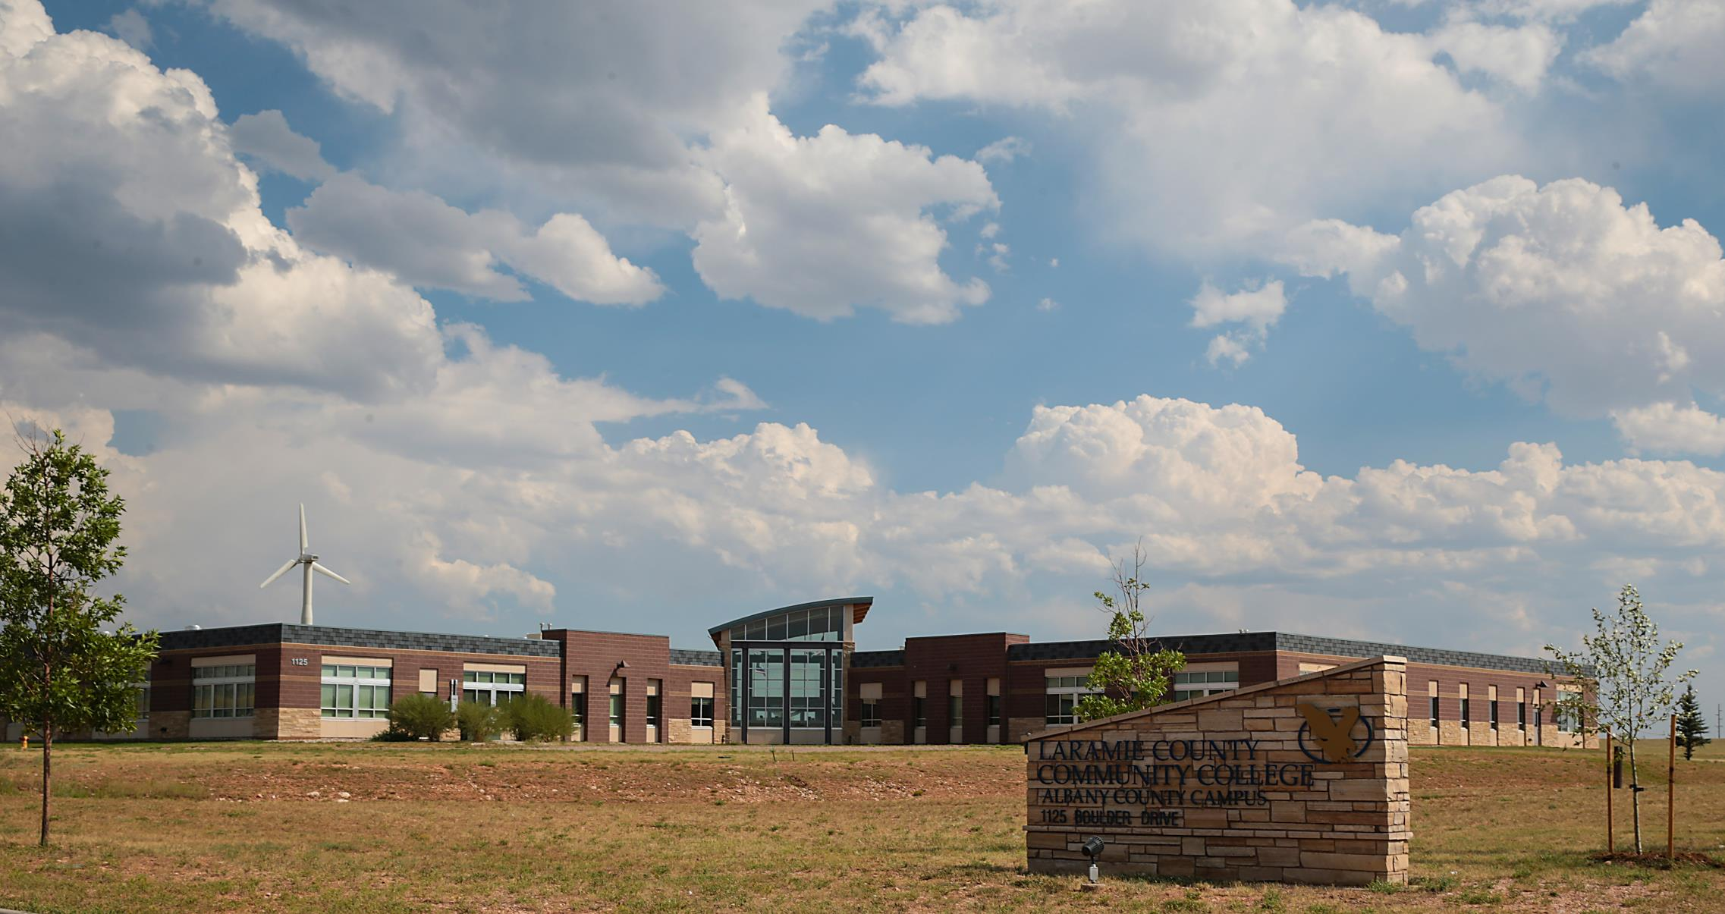

Strategic Plan
Albany County Campus
Brady Hammond
Associate Vice President of ACC
Talisha Mottinger
Director of Campus Operations of ACC

Slide 2
OUR PROCESS
Develop a Suitable Timeline
  The process began with the structuring of a timeline to completion
Involve Key Stakeholders
Once the initial timeline was established, ACC reached out to key internal and community stakeholders
The Strategic Plan was the product of a rigorous development cycle
Conduct Research
  Once the team was assembled, information needs were identified, and key research was collected.

Slide 3
OUR VISION
To become an integrated learning destination,
inspired by community to facilitate innovative education
Vision Statement, Albany County Campus

Slide 4
“The 3 Pillars”
ACC Strategic Plan
1
2
3
Integration
Innovation
Creation

Slide 5
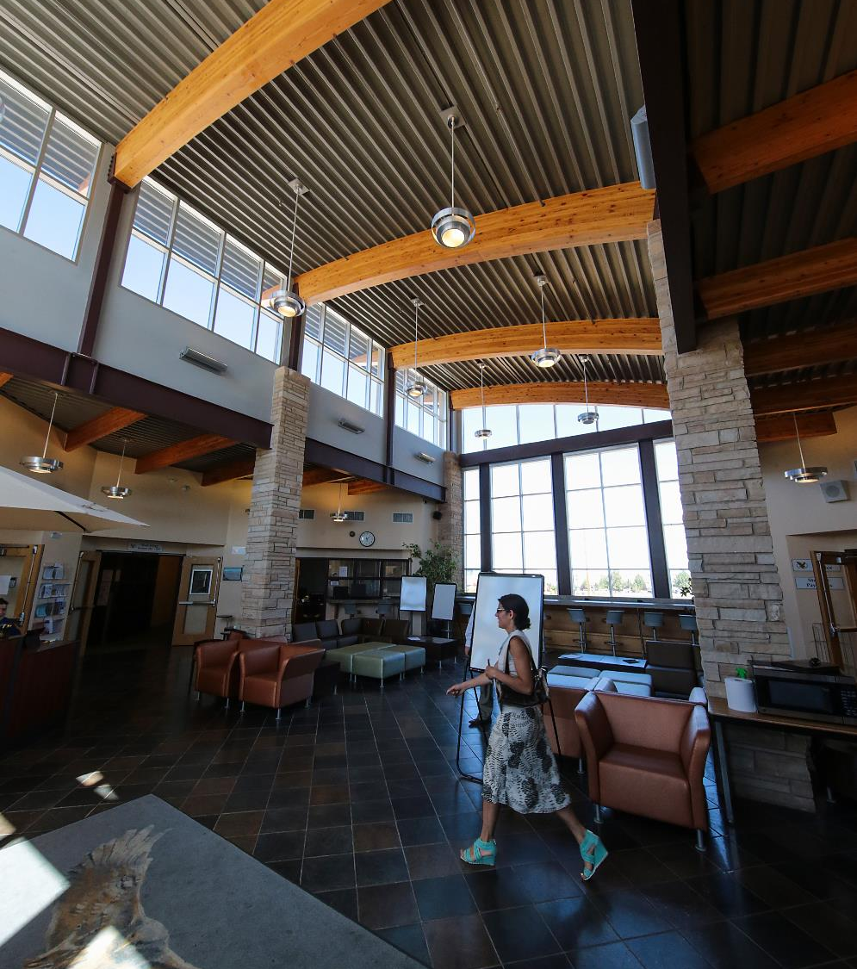
1
Integration
Integrate education into the local community by collaborating with educational partners, businesses, nonprofits, and workforce development.

Slide 6
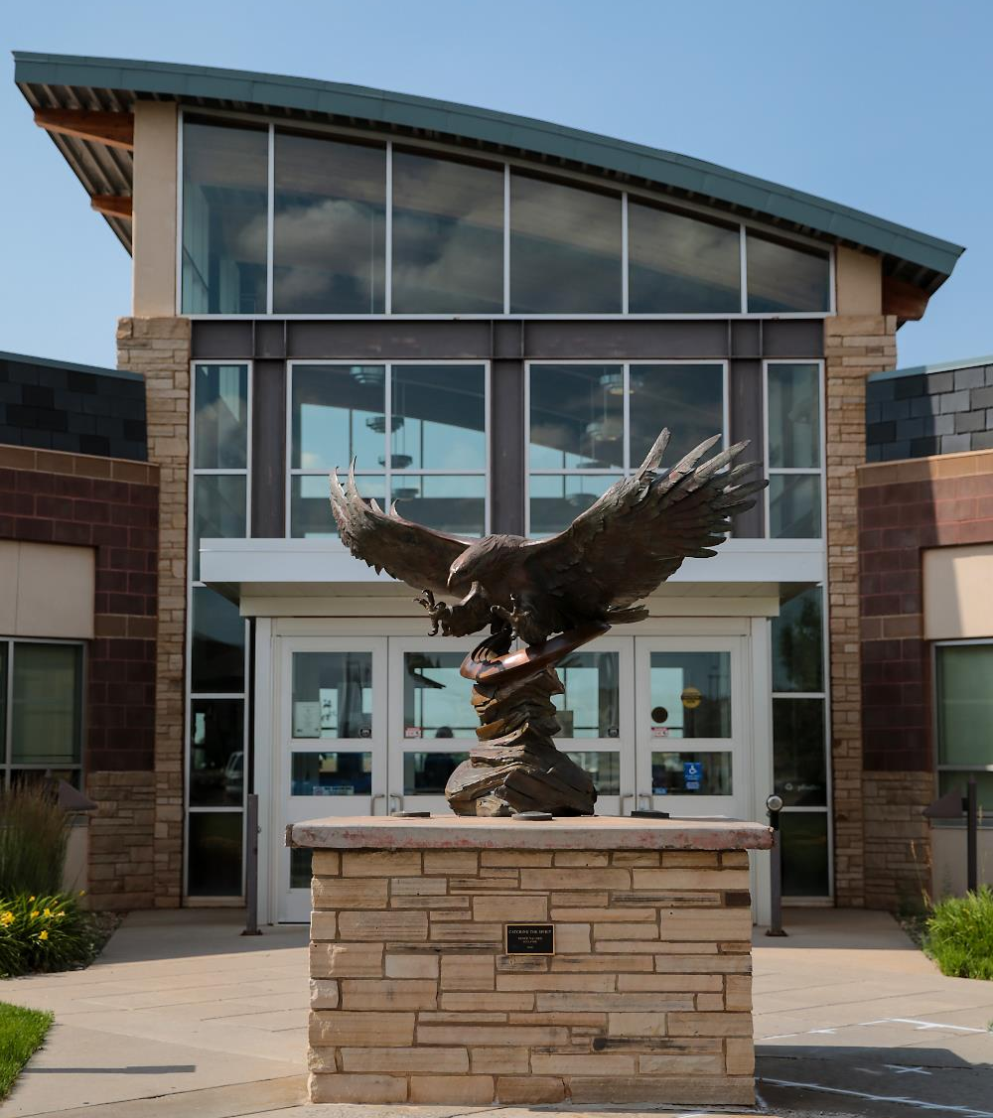
2
Innovation
Innovate new
programs and partnerships.

Slide 7
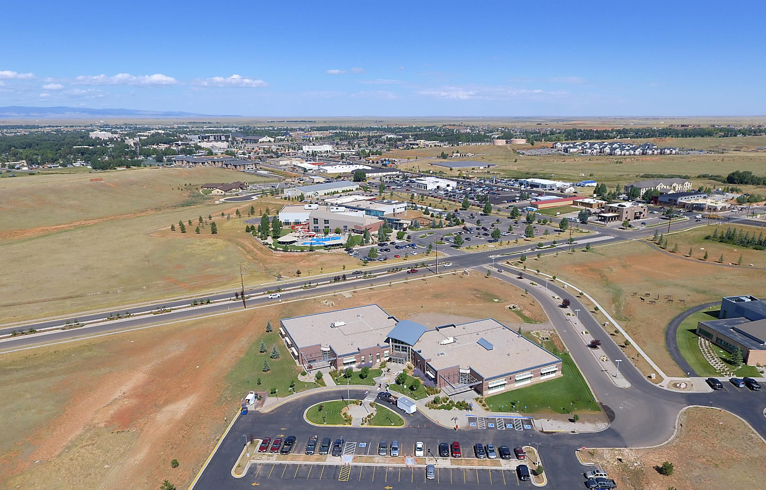
3
Creation
Create destination programming by leveraging community resources.

Slide 8
IMPLEMENTATION
Approval
  The Strategic Plan must be approved by the institution
The Strategic Plan represents the long-term goals of the ACC
Make Operational
  Each item in the plan must be operationalized
Develop Metrics
A measurement rubric must be developed to ensure that progress is accurately tracked

Slide 9
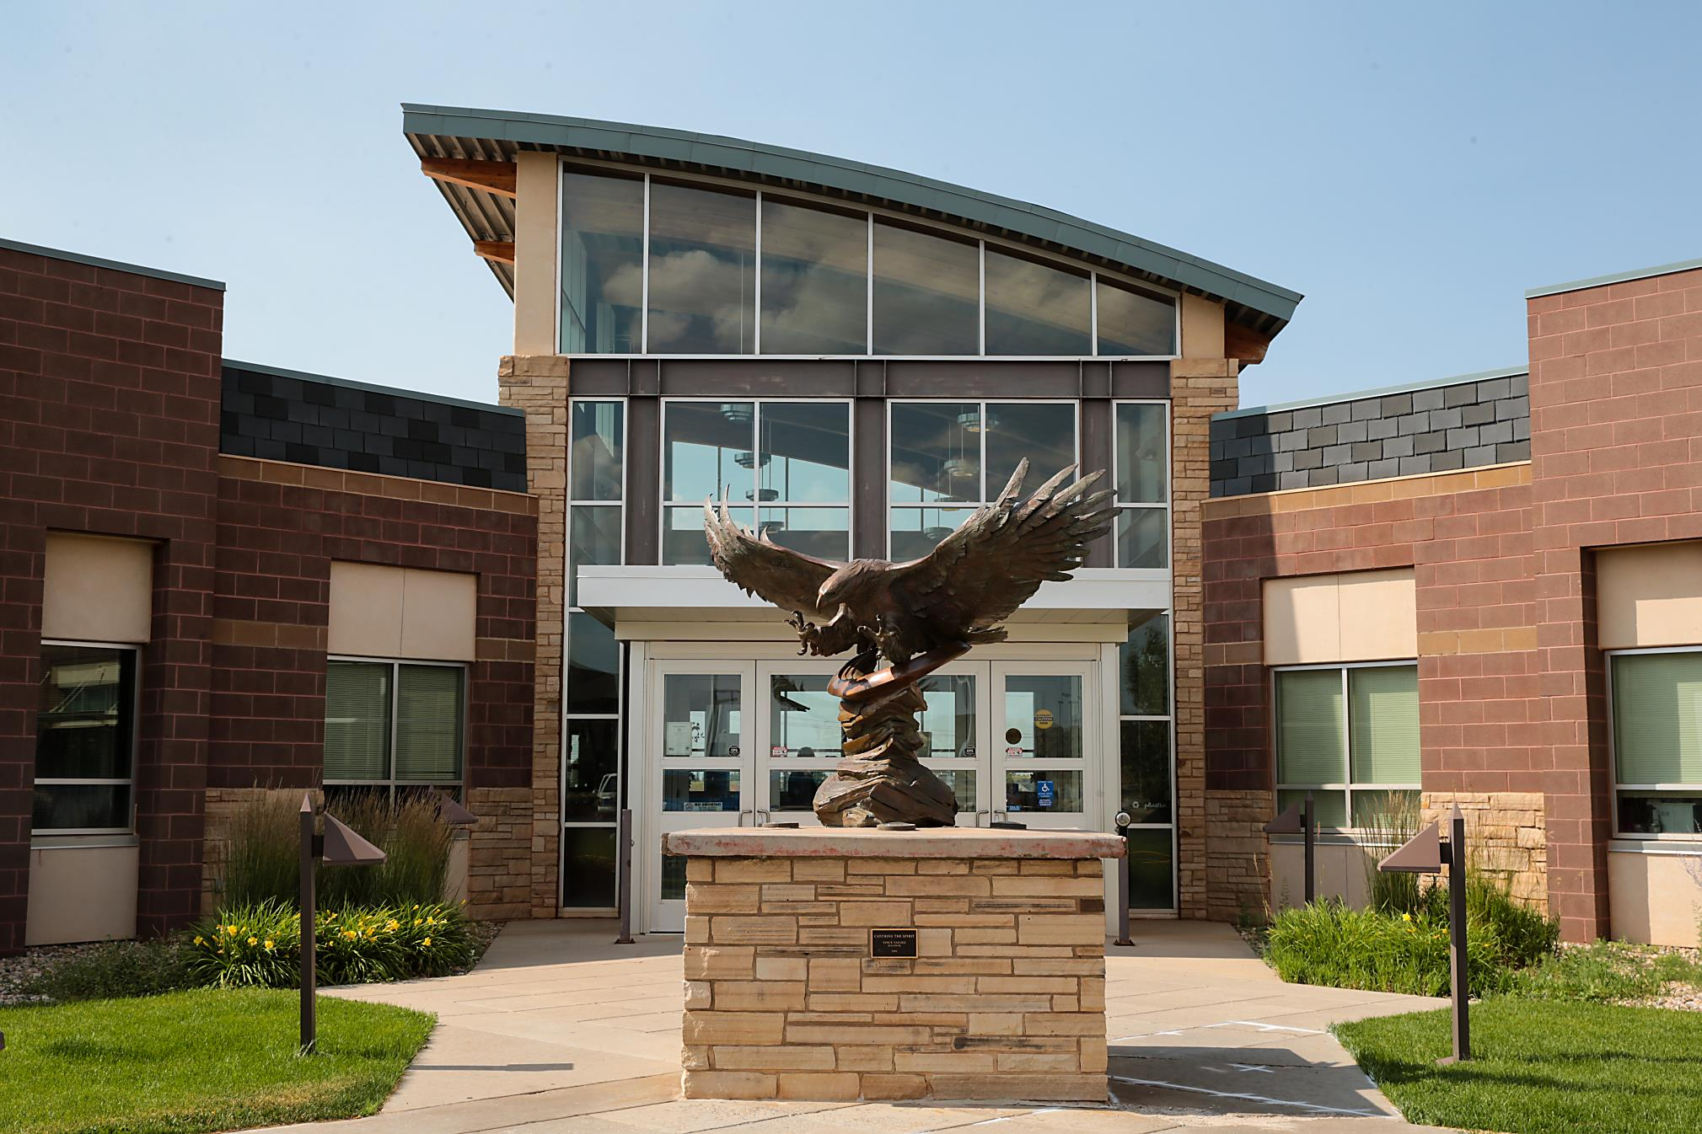
THANK YOU

Slide 10
QUESTIONS

