Slide 1
Spanish in the WorkplacE, CD
Presentation for LCCC Board of Trustees

Slide 2
Hispanic / Latino growth in wyoming
US Census Data on Population Growth by percentage from 2000 to 2020

Slide 3
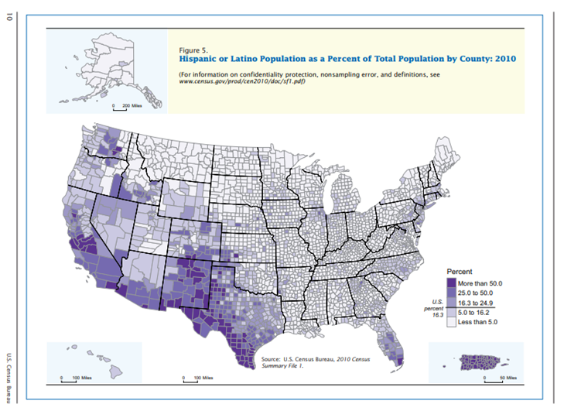

Slide 4

Community Stakeholders
Law Enforcement First Responder
Safety
Social Work
Social Benefit
Healthcare
Health
Growth
Diversity
Trades/Ag
Growth
Diversity
Response
Professionalism
Community
Connections
Business
Prevention
Connections
Economic -
Opportunities
Economic -
Opportunities

Slide 5
Stipends for bilingual ability
Colorado
Idaho
Nebraska
New Mexico
Employee | Law | Manager
$50 | $100 | $200+
Annual = $600 | Annual = $1200 | Annual = $2400

Slide 6
Community Benefits
Economic
Address needs
&
Welcome opportunities
Social
Social benefit
&
Cultural
Global citizen
&
Growth
Competitive
&
Tourism
Diversity
Strong community
Flattened world
Economic
Opportunities
&
Global
Opportunities

Slide 7
Stakeholders and audience
RECRUITING
  Existing labor force
  Law, Healthcare & Social Work
TRAINING
  Utilize LCCC Resources
  Potential on-site delivery
SERVICING
  Existing community
  Welcoming future residents
Step 1
Step 2
RECRUIT
TRAIN
SERVICE
Step 3

Slide 8
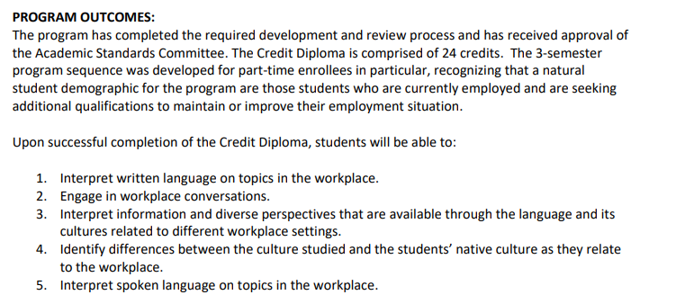
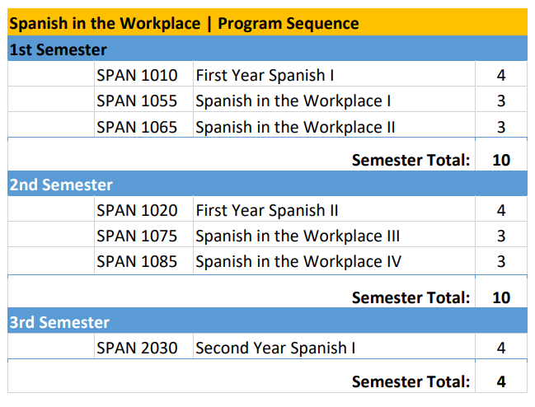

Slide 9
ORIGINATED Curriculum Overview
Spanish 1055: Novice-low level basic vocabular & verbs
Spanish 1065: Novice-mid level with basic phrases
Spanish 1075: Novice-high level with phrases & tenses
Spanish 1085: Intermediate level with narration & sequencing

