Slide 1
2025 State of the College
Presented to the LCCC Campus Community
Monday, August 11, 2025
Dr. Joe Schaffer, President

Slide 2
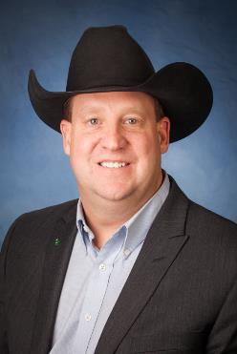

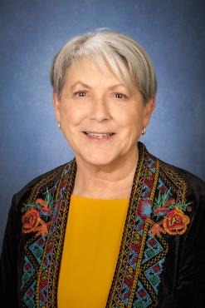
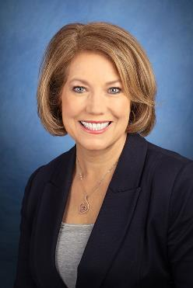
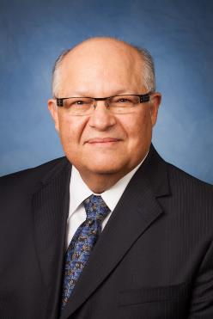
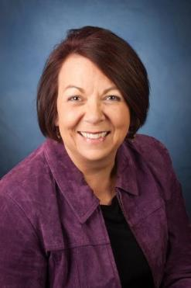

LCCC Board of Trustees
Jess Ketcham, Vice Chair
Don Erickson, Treasurer
Dr. Kathy Emmons, Secretary
Janine Thompson, Chair
Bob Salazar, Trustee
Wendy Soto, Trustee
Carol Merrell, Trustee

Slide 3
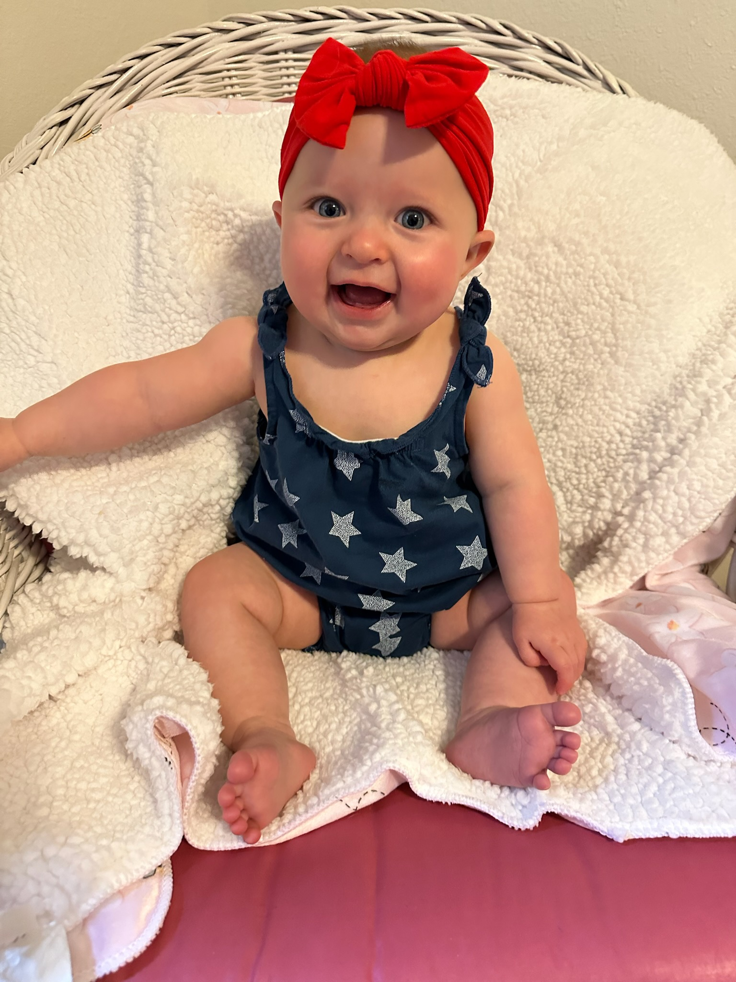

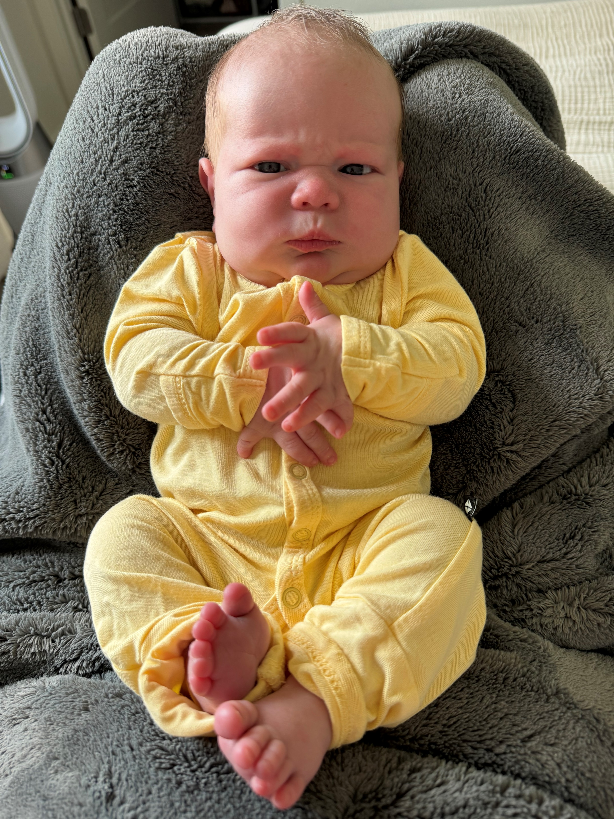
Newest Golden Eagles
Piper Mae Temte
July 22, 2025
Parents: Alexa and Ian Temte
Elliana James Ivanoff
November 7, 2024
Parents: Ariel and Lucas Ivanoff

Slide 4
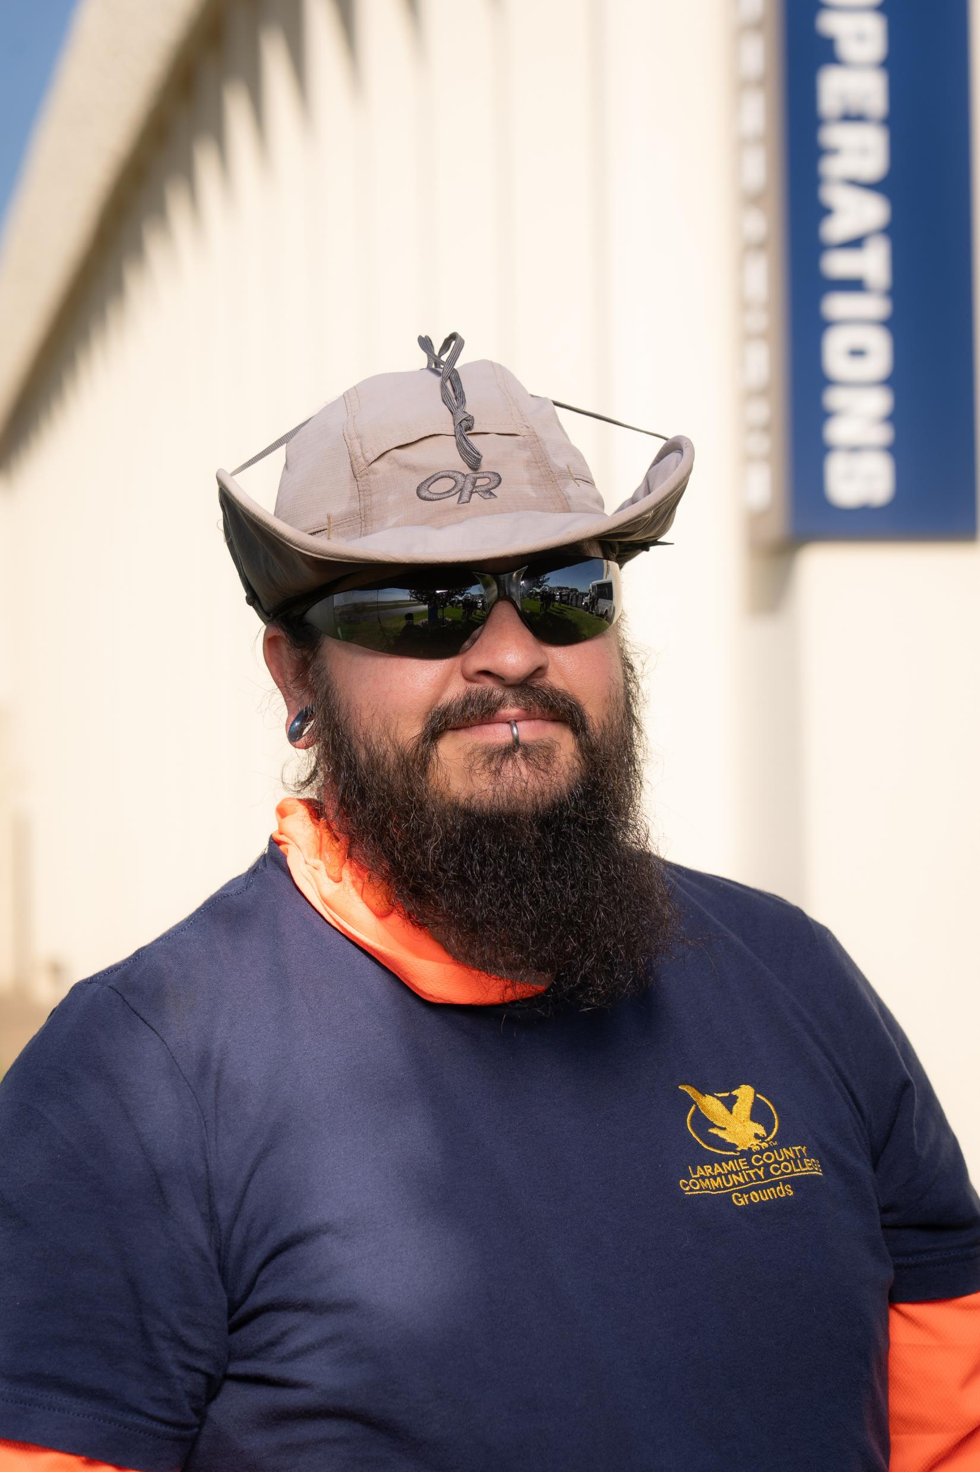
Jason Hamilton Grounds Specialist II AAS Trades & Technical Studies, LCCC

Slide 5
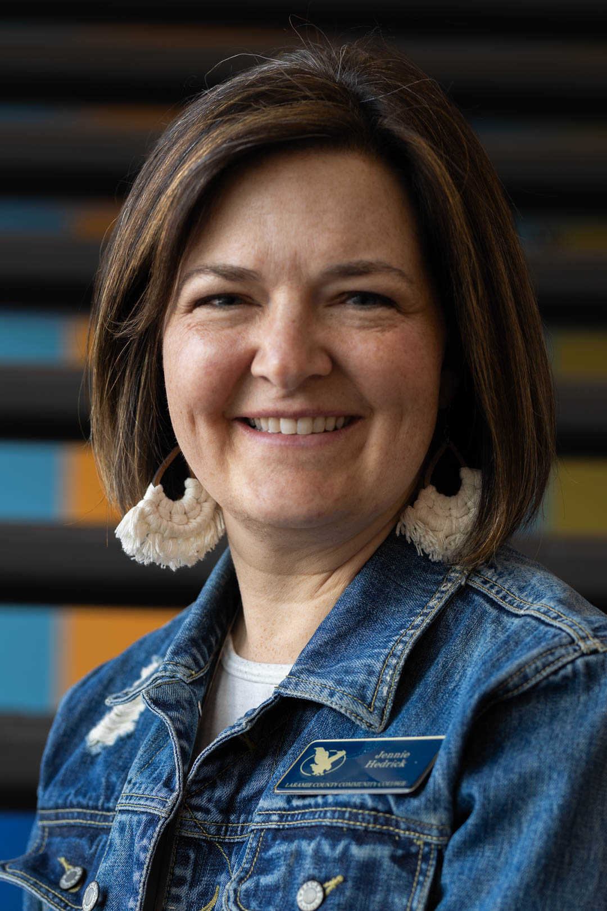
Jennie Hedrick Manager, Student Services, Laramie Campus Certificate in Community College Leadership, UW

Slide 6

Alexa Temte Executive Assistant, Administration Masters in Higher Education Administration, UW

Slide 7
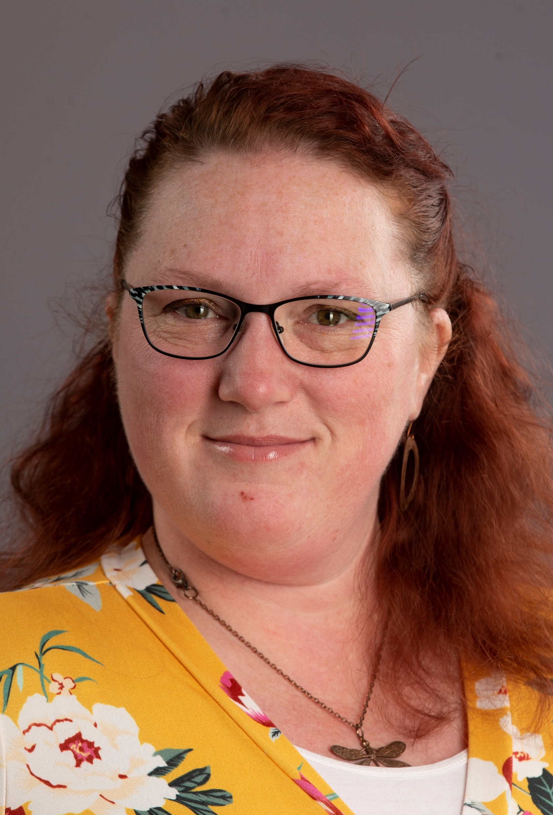
Shauna Best Technician, Accounting II Bachelors in Psychology, SNHU

Slide 8

Trista Woods Director, Accounting; Foundation Certificate in Community College Leadership, UW

Slide 9

Summer Projects
Plant Trees w/Drip
Flagstone around Fire Pit
Replace Garbage Disposal
Cut Firewood

Slide 10



“Honey, I saw this on interest…”

Slide 11
Summer Projects
Plant Trees w/Drip
Flagstone around Fire Pit
Replace Garbage Disposal
Cut Firewood
Install Sign at House
Solar Lights for the Bridge
Wheelbarrow Planter
Install Sign at Cabin
Tire Dust Bath for Chickens

Slide 12
Budget & Finances

Slide 13
Budget Overview - Funding
Unrestricted revenue primarily from three sources:
State Funding (Block Grant to WCCC)
Local Ad Valorum Taxes (Property Taxes)
Tuition and Fees
Other Revenue (Restricted) – Grants, contracts, special appropriations, etc.

Slide 14
Budget Overview - FAM
Funding Allocation Model (FAM)
How the WCCC distributes state funding – equity model
Includes three unique components:
Fixed Costs of a College (60%)
Variable Costs of a College (40%)
Local Tax Revenues Received

Slide 15
* 3 Small Footnotes
Allocation of variable cost funding is based on performance measures:
Participation (enrolled weighted student credit hours – 50%)
Persistence (completed weighted student credit hours – 25%)
Performance (credentials awarded – 25%)
Recapture/redistribution of state funds
FAM incentivizes equity, at the expense of progress

Slide 16
County Valuation |  | 2015 | 2024 | % Chg since 2015 | $ Chg since 2015
Fremont |  | $ 916,766,870 | $ 851,212,824 | -7% | $ (65,554,046)
Goshen |  | $ 178,816,995 | $ 305,745,621 | 71% | $ 126,928,626
Laramie |  | $ 1,384,962,686 | $ 2,788,718,624 | 101% | $ 1,403,755,938
Natrona |  | $ 1,463,660,769 | $ 1,603,322,909 | 10% | $ 139,662,140
Park |  | $ 869,641,470 | $ 1,000,217,112 | 15% | $ 130,575,642
Sheridan |  | $ 422,627,851 | $ 744,977,494 | 76% | $ 322,349,643
Sweetwater |  | $ 2,961,509,848 | $ 2,657,431,821 | -10% | $ (304,078,027)

Slide 17
Some funding high Points
9.5% ($16.6M) – Increase in state funding for the WY CC’s over the past 10 years.
18% ($13.5M) – Increase in local funding for the WY CC’s.
35.6% – Cumulative inflation in WY over the past 10 years.
---------------------------------------
-17.3% ($8M) – Decrease in state funding for LCCC over the past 10 years.
103% ($12.8M) – Increase in local funding for LCCC
8.2% ($4.8M) – Increase in funding to LCCC – 27.1% shy of inflation, let alone fueling growth/progress.

Slide 18



Changes in unrestricted Funding % of Budget
FY15
60%
13%
23%
FY26
42%
25%
24%
-18%
12%
1%
NOTE: Percents do not equal 100% due to rounding and exclusion of “other” funding in the annual budget.

Slide 19
Funding Overview for FY26
State Funding Total = $25,023,241 (down $1.8M from FY25)
Gained funding based on Performance
Lost funding from Fixed/Variable Costs Recalibration/Errors
Lost funding from Recapture/Redistribution
Local Funding = $15,283,288 (down about $304K from FY25)
Impacts of property tax exemptions less than anticipated… for now
Tuition and Fees = $14,277,347 (up about $644K from FY25)
Increasing enrollment are helping off-set losses in revenue

Slide 20
How We Invest
96% of budget is already committed to ongoing expenses.
Mostly tied to employees (salaries/benefits) – 67%
Making new investments is challenging, but we are committed to doing so.
Focus will increasingly be on freeing up resources internally through reallocation.

Slide 21
3 Ways We Are Investing in FY26
Investments made through new funds.
New Faculty (Auto Tech, Health Sciences, etc.), Retention Incentive for Employees
Investments made through reallocation of existing funds.
Test Center Proctor, Marketing, Athletics, Student Experience, etc.
Investments made through strategic use of Fund Balance (savings).
Strategic Plan, Learning Spaces Master Plan, Fleet Vehicles, Arena Sound System, Equipment Replacement, etc.

Slide 22
Transparency Challenges
Ensuring transparency and understanding of investments is becoming increasingly problematic.
One Mill budget is clear.
Using Fund Balance is clear.
General Fund is less and less clear – especially with volatility in revenue, loss of state funding, and significant internal reallocation of funds.

Slide 23
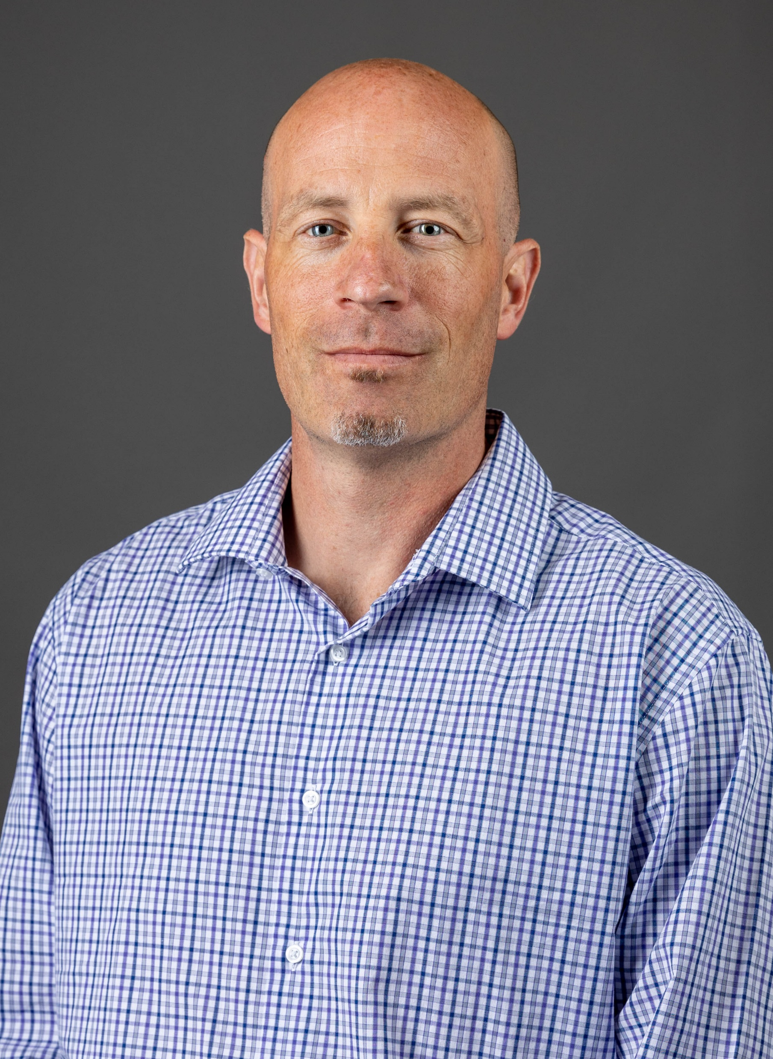
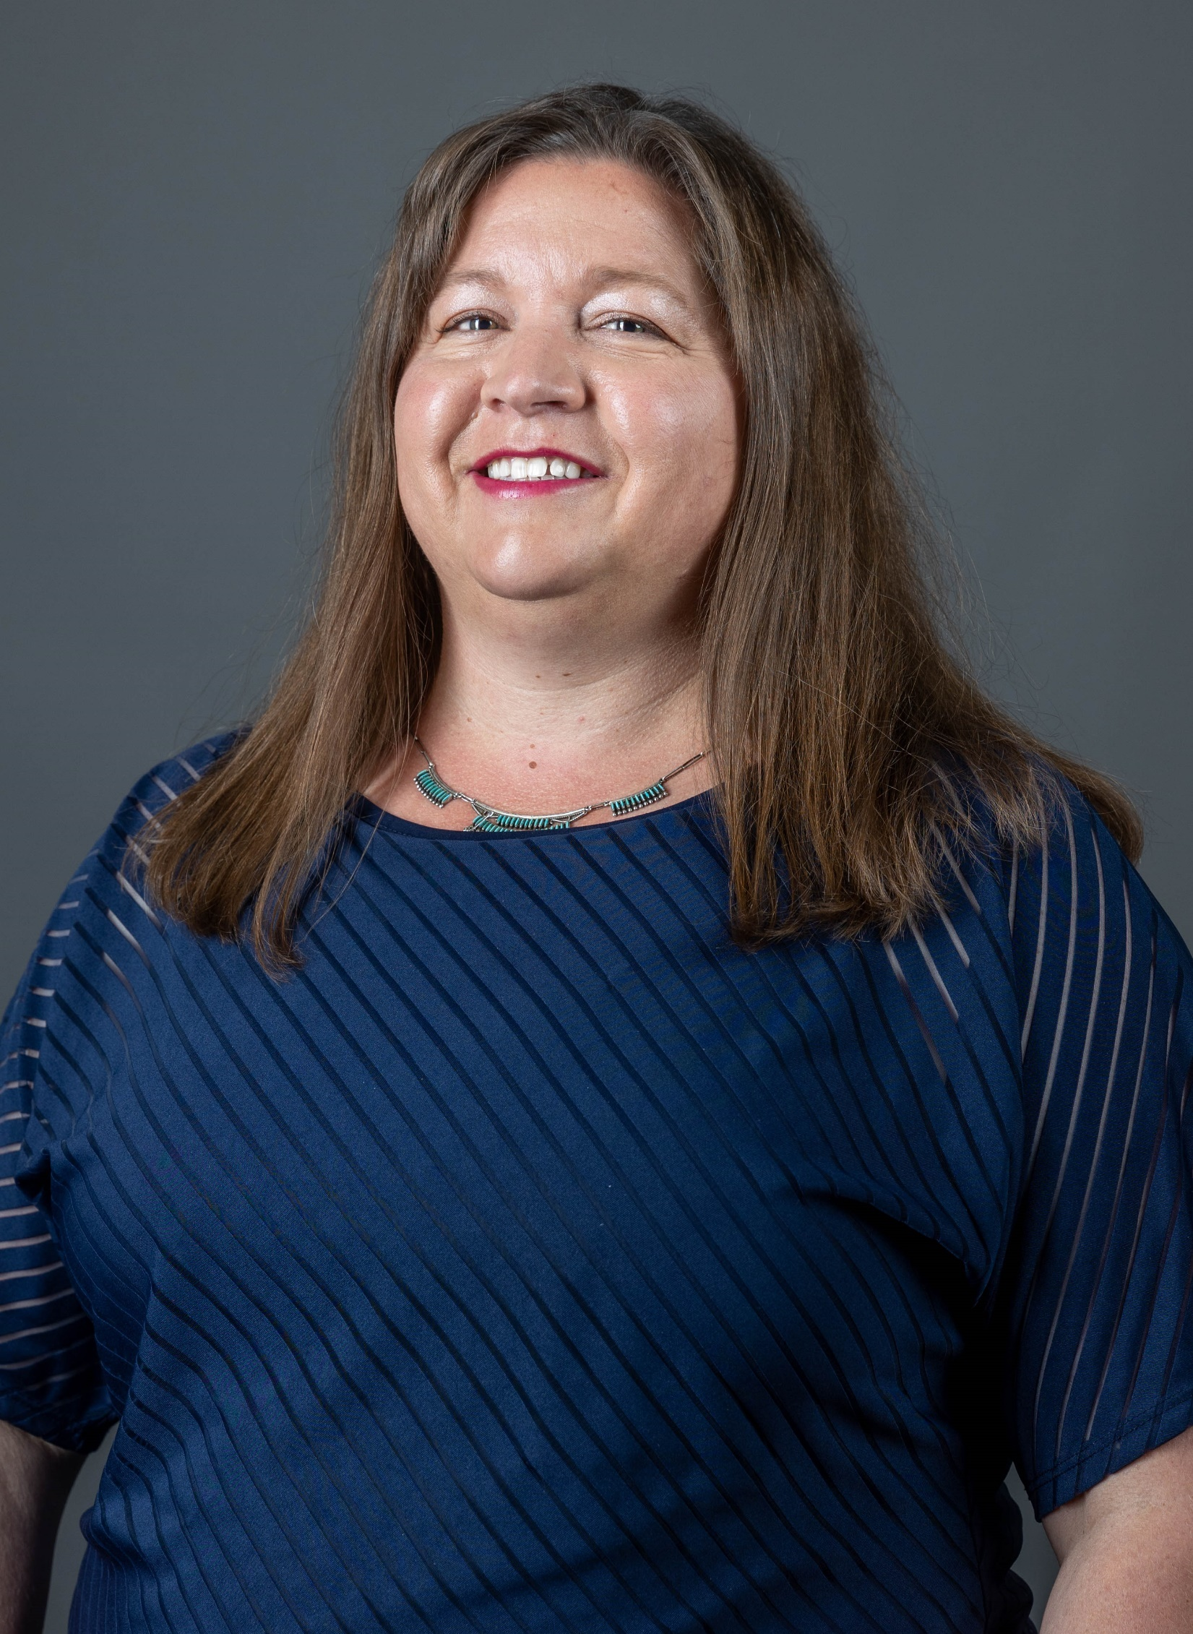

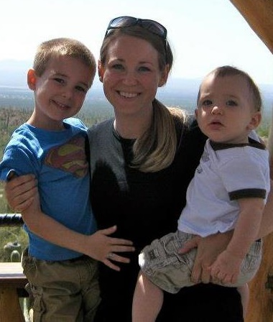
Shaun Ziegler Budget Director
Money Magic at LCCC
Jennifer McCartney
Director, Sponsored Awards and Compliance
Krysten Miller
Sponsored Awards and Compliance
Nola Rocha
Comptroller

Slide 24
Student Enrollment

Slide 25
LCCC Enrollment Update
Source: LCCC Office of Institutional Research

Slide 26
Enrollment by LCCC Pathway
Source: LCCC Office of Institutional Research Annual Enrollment Dashboard, Academic Year 24/25 Degree Seeking Students

Slide 27

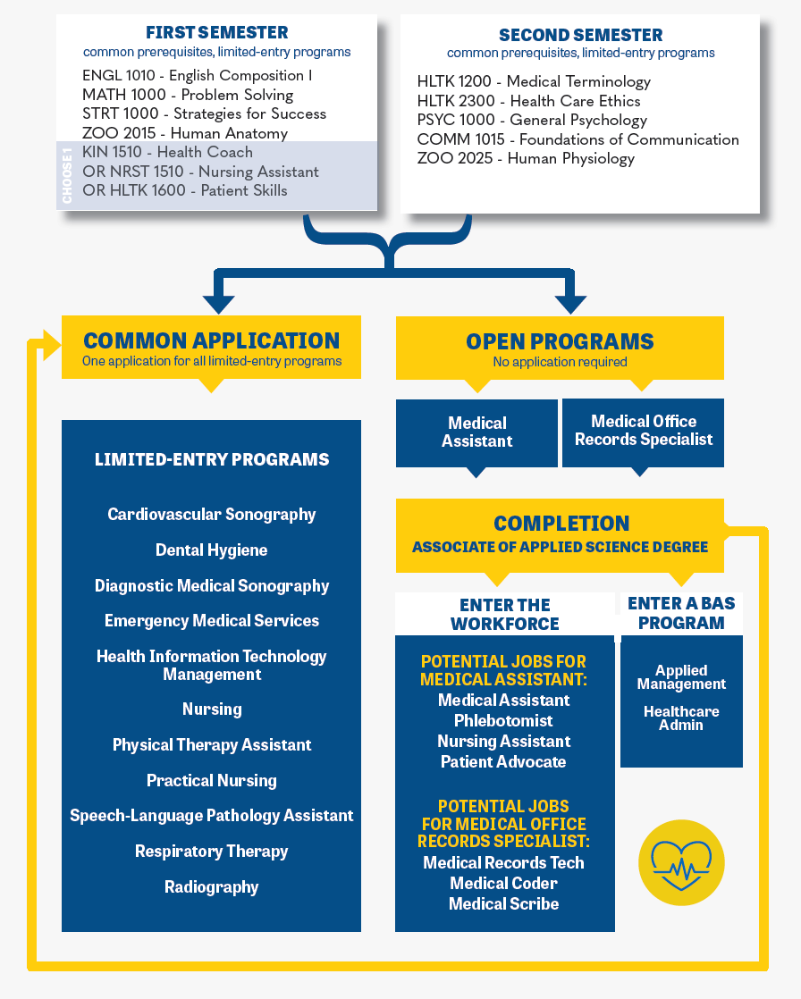
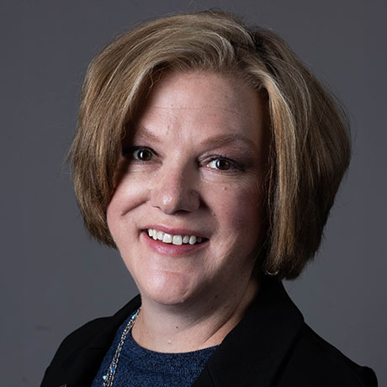
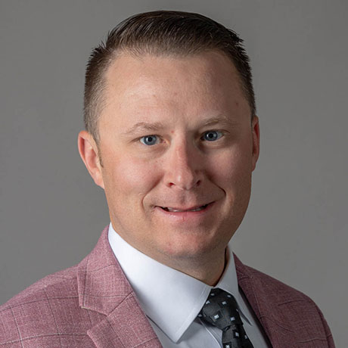
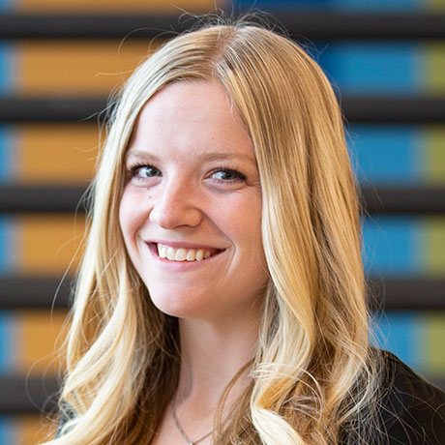

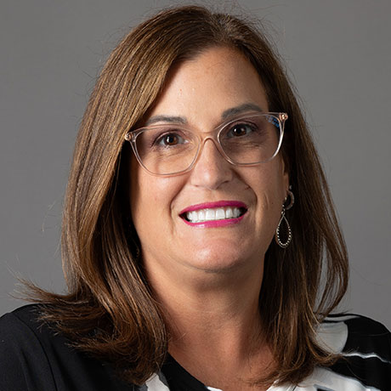
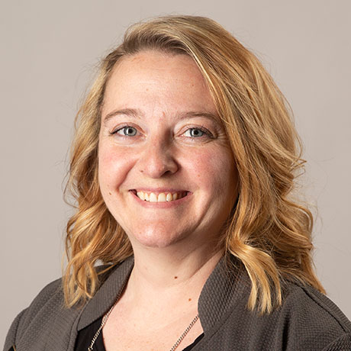
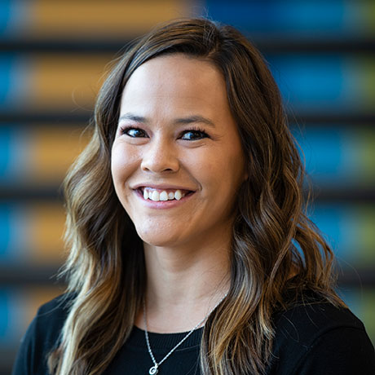

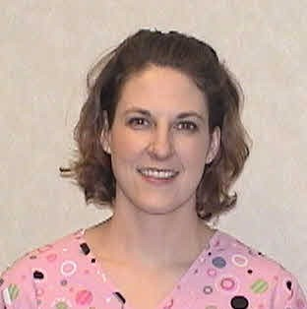
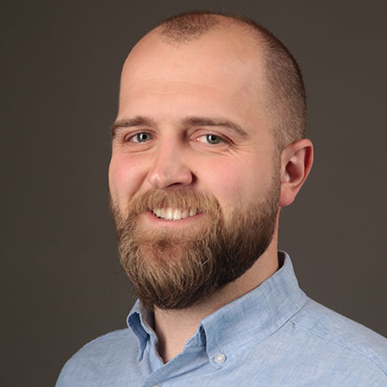
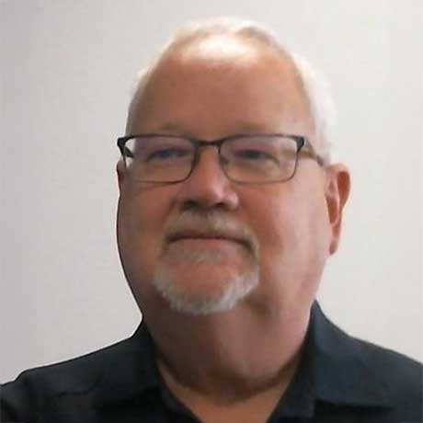
Healthcare Excellence
New Pathway Structure
Dr. Karen Bowen, Dean School of Health Sciences & Wellness
Bryan Wilson, Dean School of Arts & Sciences
Kaycie Kilmurray Manager, Student Success
Ashleigh Ralls
Angela Burge
Danielle Opp
Alexa Barker
Adrienne Wade
Amber Braunschweig
Brendon Larsen
Larry Jones
Notes:
Our frontier mentality will not allow us to be encumbered by habits of old constructs. Rather, we are engineered to be nimble, driven towards innovation, striving to make the impossible, possible.

Slide 28
Fall Enrollment Trends
Source: LCCC Office of Institutional Research

Slide 29
Source: LCCC Office of Institutional Research

Slide 30
Statewide Enrollment Comparisons
Source: Wyoming Community College Commission (WCCC) Daily Enrollment Dashboard available at https://analytics.wy.edu/DailyEnrollment

Slide 31
Statewide Enrollment Comparisons
Source: WCCC Daily Enrollment Dashboard available at https://analytics.wy.edu/DailyEnrollment

Slide 32
High School Enrollments
Source: LCCC Office of Institutional Research, Final Annual Enrollment Dashboard

Slide 33




LCCC Accelerate
“Proof of Concept”
What if high school students:
Participated in deep career exploration to help them pick a path that aligns with their post-high school goals ?
Developed strategies for completion of both high school and college courses ?
Participated in co-coaching opportunities with both an LCCC Accelerate Coach and LCSD1 Counselor to develop an individualized student success plan ?
Utilized an “Accelerate On-Ramp” to identify and enroll in Dual and Concurrent Enrollment opportunities that allow exploration with progress to a credential ?
Received continued support (counseling, advising, etc.) to help them advance in their chosen pathway while in high school?

Slide 34
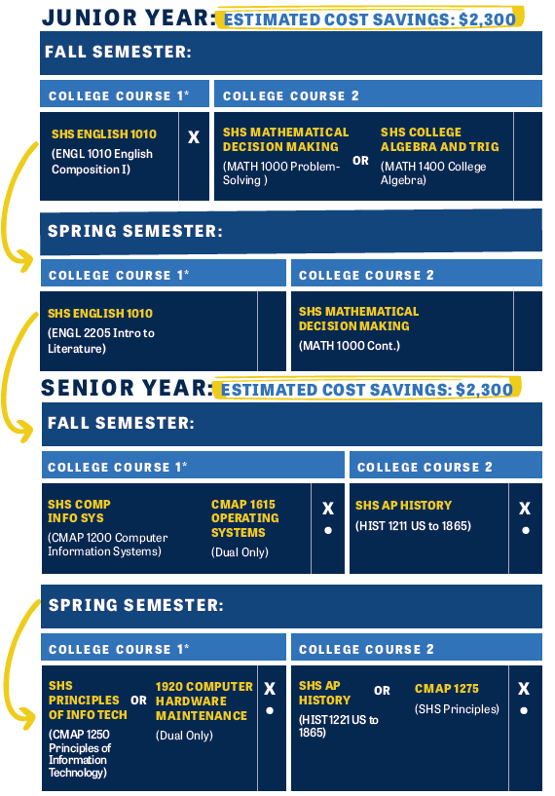

LCCC Accelerate
Sophomore Students
Priority for 1st-Gen & low-income
Attend 6 mandatory workshops to learn about career opportunities and college preparedness
Co-Coaching/Counseling to develop an individualized student success plan for junior and senior year and into freshman year of college
Take college courses in high school using an Accelerate “On-Ramp”
No course limits in HS and tuition-free first year at LCCC

Slide 35

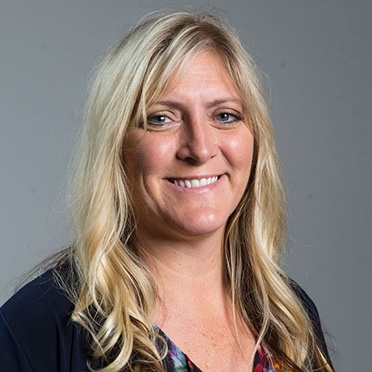
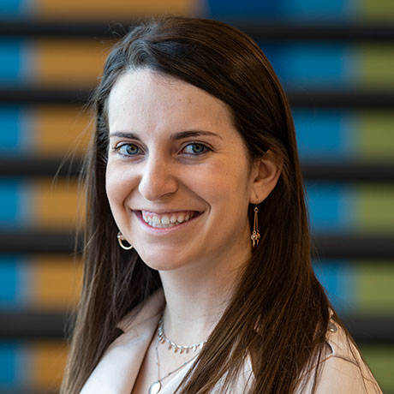


Jill Stringer Mathematics Faculty
Blake Paintner
Director, College & Career Transitions
$600,000

Slide 36
Student success

Slide 37
Student Success starts at the Course Level
Source: Wyoming Community College Commission Data

Slide 38
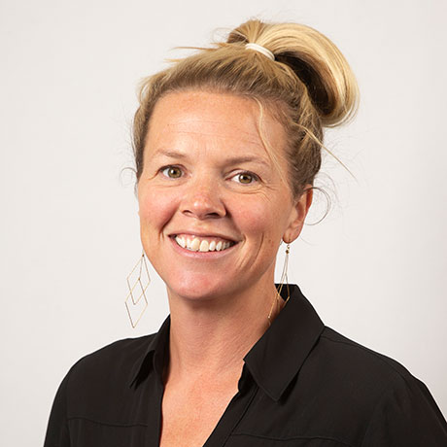
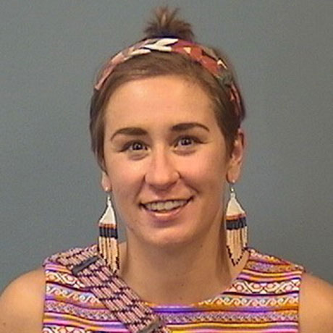


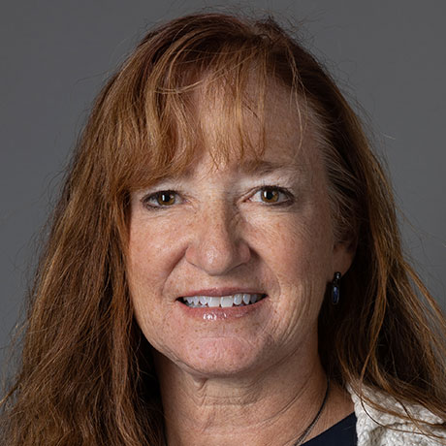
Course Success Transformation – Zoo
Nick Marcello
Katie Blunn Zoology/Biology Faculty
Paige Dingess Life Sciences Faculty
Heather Talbott
57.1% to 80.4%
5 Year Change in Course Success Rates!
Lori Britton
Source: LCCC Office of Institutional Research

Slide 39
Student Success – Credentials Awarded
Source: LCCC Office of Institutional Research

Slide 40
Student Success – Graduates & Credentials
 | Credentials | Graduates
10yr % Change | 20.3% | 6.3%
3yr % Change | 34.1% | 22.9%
Source: LCCC Office of Institutional Research

Slide 41
Student Success – Credentials by School
40.1%
24.6%
-9.4%
Source: LCCC Office of Institutional Research

Slide 42
Student Succes – Credentials by pathway
24/25
Credentials:
97
212
360
43
28
63
33
140
Source: LCCC Office of Institutional Research

Slide 43
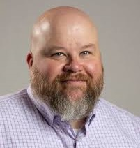
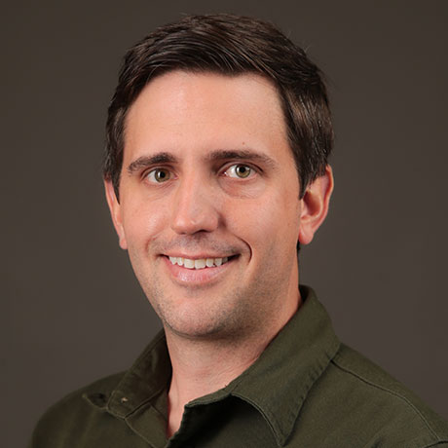
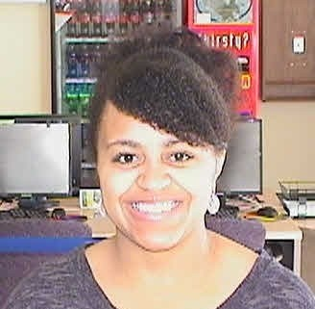

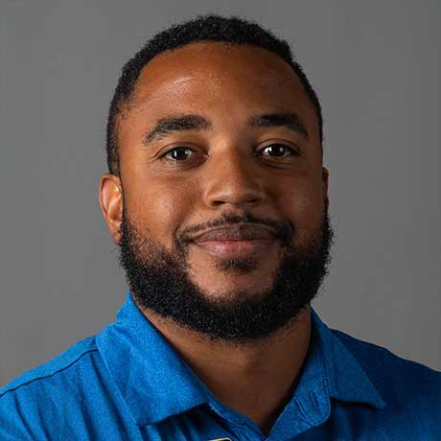
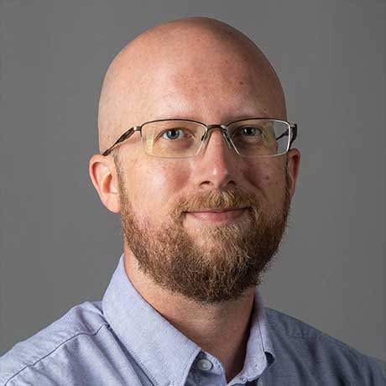
IT Pathway Progress
Troy Amick, Director
Tyler Esp, Faculty
Jasmine Varos, Faculty
JT Haskell, Faculty
Avery Mitchell, Faculty
Justin Freeland, Faculty
Source: LCCC Office of Institutional Research

Slide 44
62%
42%
45%
Part-Time
Students
First-Generation
Low-Income (pell)
Source: LCCC Office of Institutional Research, 2024-2025 Degree-Seeking students

Slide 45
We still have gaps, some big
Source: LCCC Office of Institutional Research

Slide 46
Part-Time Persist the Least
Source: LCCC Office of Institutional Research

Slide 47
Not surprisingly, they Don’t Graduate
Source: LCCC Office of Institutional Research

Slide 48
What Works?
#1.) Guided Pathways + Proactive Advising + Monitoring/Intervention + Momentum Credit Loads
How they work together:
Guided Pathways provides clear degree maps; student see what is required.
Proactive advising ensures students develop an individualized plan to follow the maps and adjust if needed.
Advisors encourage students to take 6+ credits each term (momentum), even part-time.
Early student engagement and progress is monitored, reported, and acted upon if risks arise.
Why it’s effective: Students avoid excess credits, stay on track, receive supports when they struggle, and build early progress - a strong predictor of graduation.

Slide 49

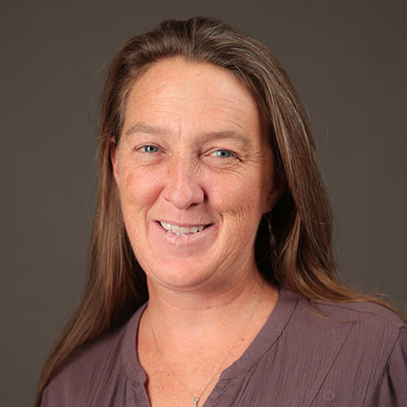

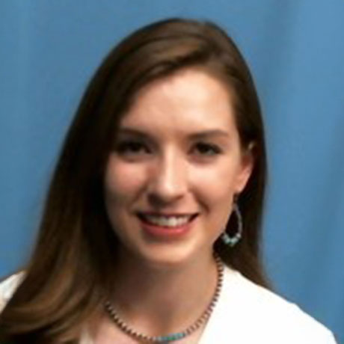
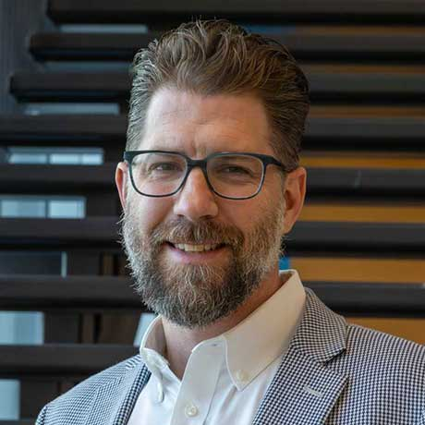
Where we are on point:
Pathways and program maps!
Success Coach model of Advising!
Roll out of Individualize Success Plans and STRT 1000!
What we will work on this year:
Encouraging part-time students to do “one more”
Implementing early progress reporting
Part-Time, Pell, and 1st Generation Students (may include others)
2nd week of class, simply asking: “Has the student engaged and progressed in class?”
Trent Morrell, STEM Pathway Coordinator
Meghan Kelly, Associate Dean, Library
Alli McCowen, Asst. Dir. Enrollment Services
Katie Shockley, Ag & Equine Pathway Coordinator
Ben Herdt, Director Enrollment Services

Slide 50
What Works?
#2.) Wraparound Supports + Financial Incentives/Aid + Advising/Coaching
How they work together:
Students meet regularly with an advisor or coach who helps navigate both academic and life issues.
Emergency aid or incentives are built into the advising relationship.
Need based aid is available to off-set time spent learning and not earning.
Referrals to food, housing, or childcare supports are embedded in this model.
Why it’s effective: Holistic care builds trust and reduces external barriers that disproportionately affect part-time students and adult learners.

Slide 51
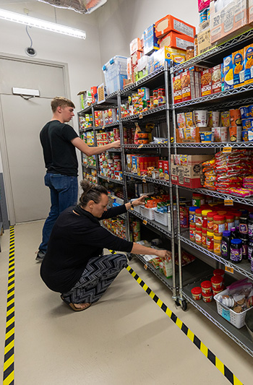
Where we are on point:
Success Coach model of Advising!
Pathway Coordinators and the Pathway Leadership Teams!
Excellent resources (e.g., counseling, FNBO Food Pantry, transitional services fun, etc.)!
More need-based aid (e.g., Wyoming’s Tomorrow, etc.)!
What we will work on this year:
Developing better interventions and tying wrap around services and resources to early term student alerts.

Slide 52
What Works?
#3.) Flexible, Predictable Scheduling + Accelerated Formats + Corequisite Dev Ed
How they work together:
Courses offered in set, repeating time blocks (e.g., evenings, weekends, or hybrid) so students can build consistent schedules around work and family.
Predictable scheduling allows students to plan (and register) multiple terms ahead without guessing if a course will be offered.
Courses offered in accelerated formats (e.g., 8-weeks) allow students to take one or two classes at a time in short bursts and still earn 12+ credits in a year.
Integrated developmental content with college-level coursework allows students to earn credit from day one.
Why it’s effective: Removes remediation barrier, helps part-time students build momentum, increases persistence through structure, and aligns with guided pathways structures.

Slide 53
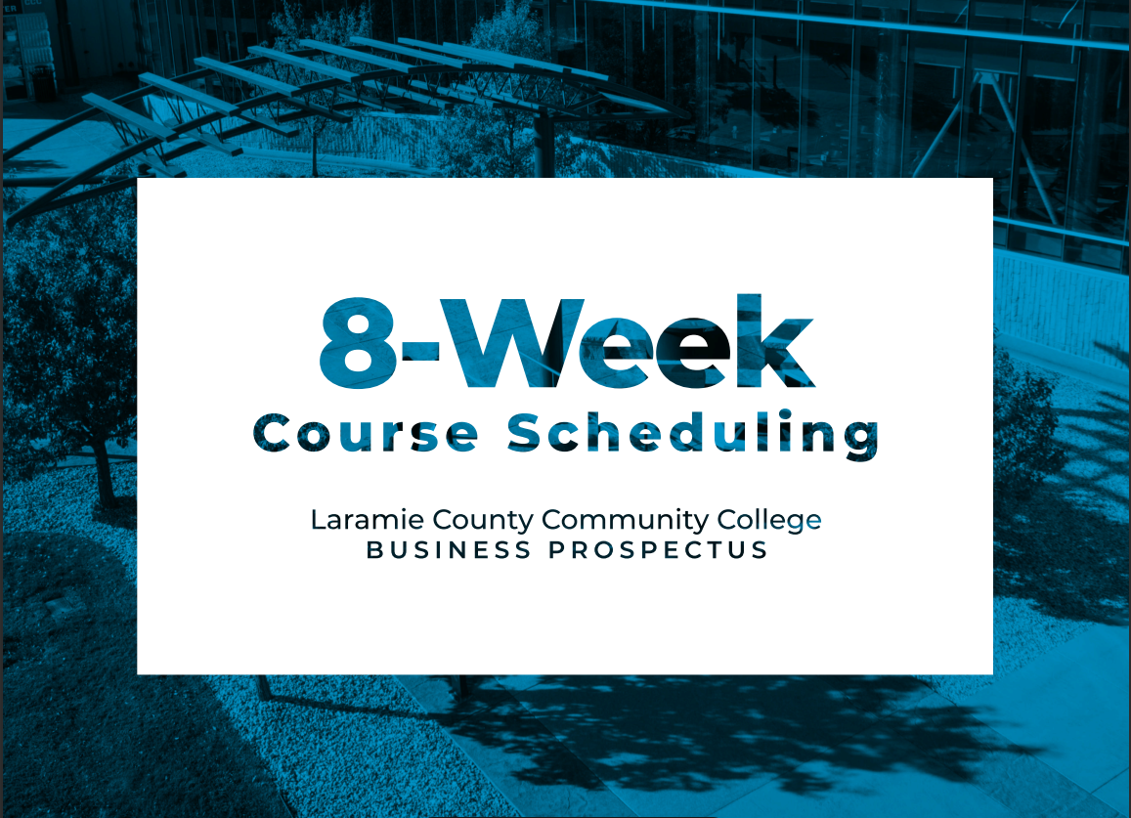
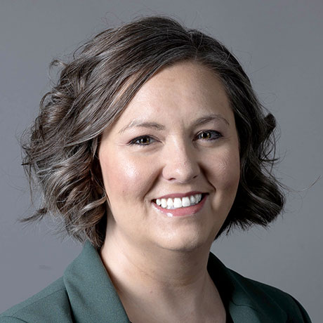

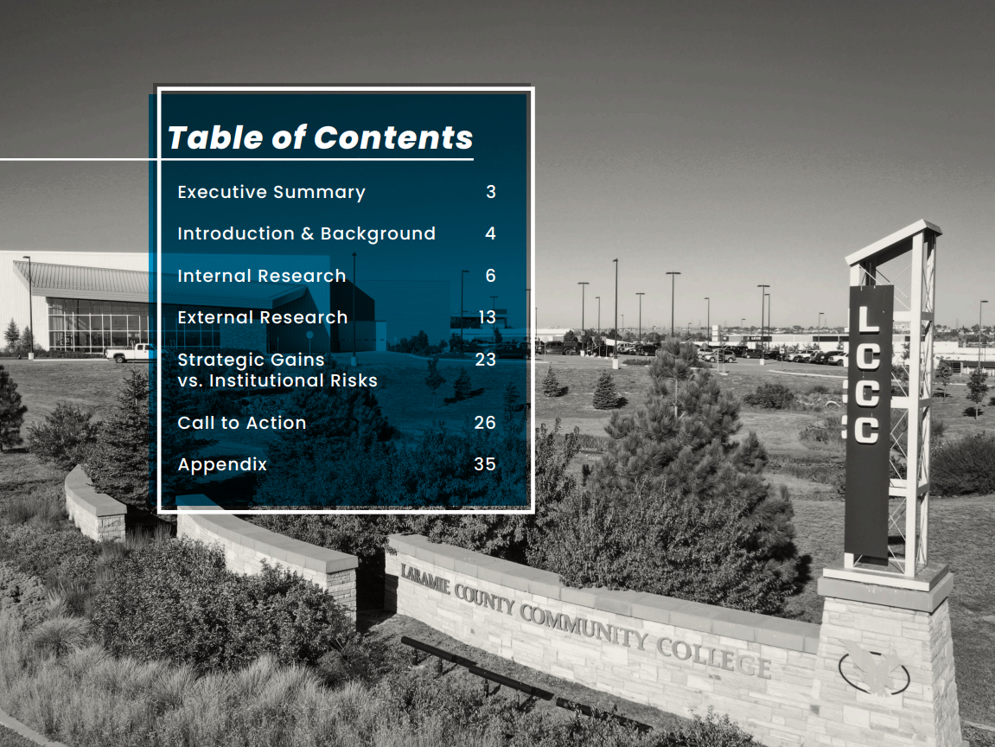
Where we are on point:
LCCC has been doing Co-requisite Math & English for years!
Some programs have structured curricula and implemented block schedules, which appears to work!
What we will work on this year:
The big question – are we moving to 8-week structure as the primary delivery format?
Sheridan Hanson, Director Center for Excellence in Teaching
Stacy Maestas
Registrar

Slide 54
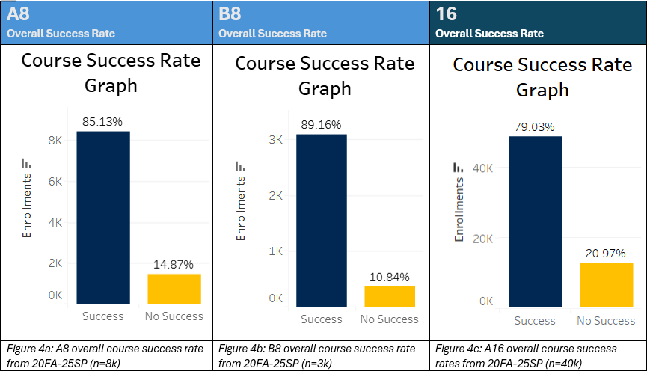
Overall Data Appear Compelling
Source: LCCC Office of Institutional Research, Course Success Dashboard

Slide 55
Source: LCCC Office of Institutional Research, Course Success Dashboard

Slide 56
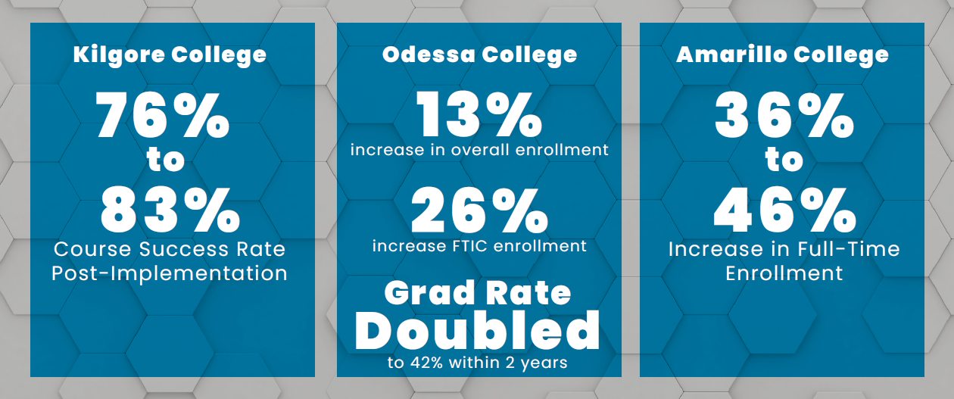

Some Promising External Evidence

Slide 57
Summer Projects
✓
Plant Trees w/Drip
Flagstone around Fire Pit
✓
Replace Garbage Disposal
✓
Cut Firewood
✓
Install Sign at House
✓
Solar Lights for the Bridge
✓
Wheelbarrow Planter
✓
Install Sign at Cabin
✓
Tire Dust Bath for Chickens

Slide 58
Final Thoughts On Scheduling
Doing nothing isn’t an option…
Seeking feedback, additional options, alternatives, not just critique.
When to tackle changes to scheduling may be as important as answering what to tackle.

Slide 59
cliff of knowledge & Sea of sameness

Slide 60
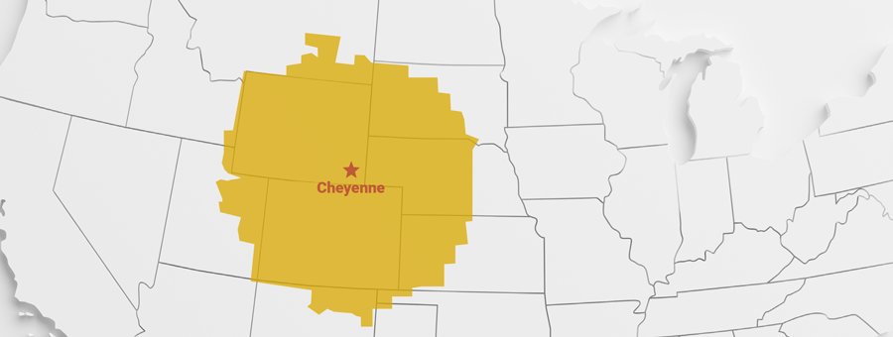
Goal 1: Become the best-known higher education value within 350 miles of Cheyenne
Why this Goal?
HS Graduate Decline
Losing Wyoming’s Youth (Aging Population)
3:1 Ratio of College Educated Adults
Critical for Economic Prosperity & Diversity

Slide 61

Initial Research
We are well-known in our service area, but not far beyond that.

Slide 62




Levers – Awareness/Affordability
34%
34%
24%
14%

Slide 63
2019/2020
2024/2025
570
444
715
469
Other Wy
EDGE States
Source: LCCC Office of Institutional Research, Final Annual Enrollment Public Dashboard

Slide 64

Brand Analysis
Three major tasks:
Assess brand - design, messaging, social media, website
Conduct focus groups on campus (employees, students)
Create and conduct a survey of Wyoming, Colorado, Nebraska and South Dakota to assess:
Awareness and familiarity with LCCC
Perceptions of the College’s name and its clarity
Impact of the name on appeal, credibility, and enrollment decisions
Confusion around location and branding
Sentiment toward potential name change

Slide 65
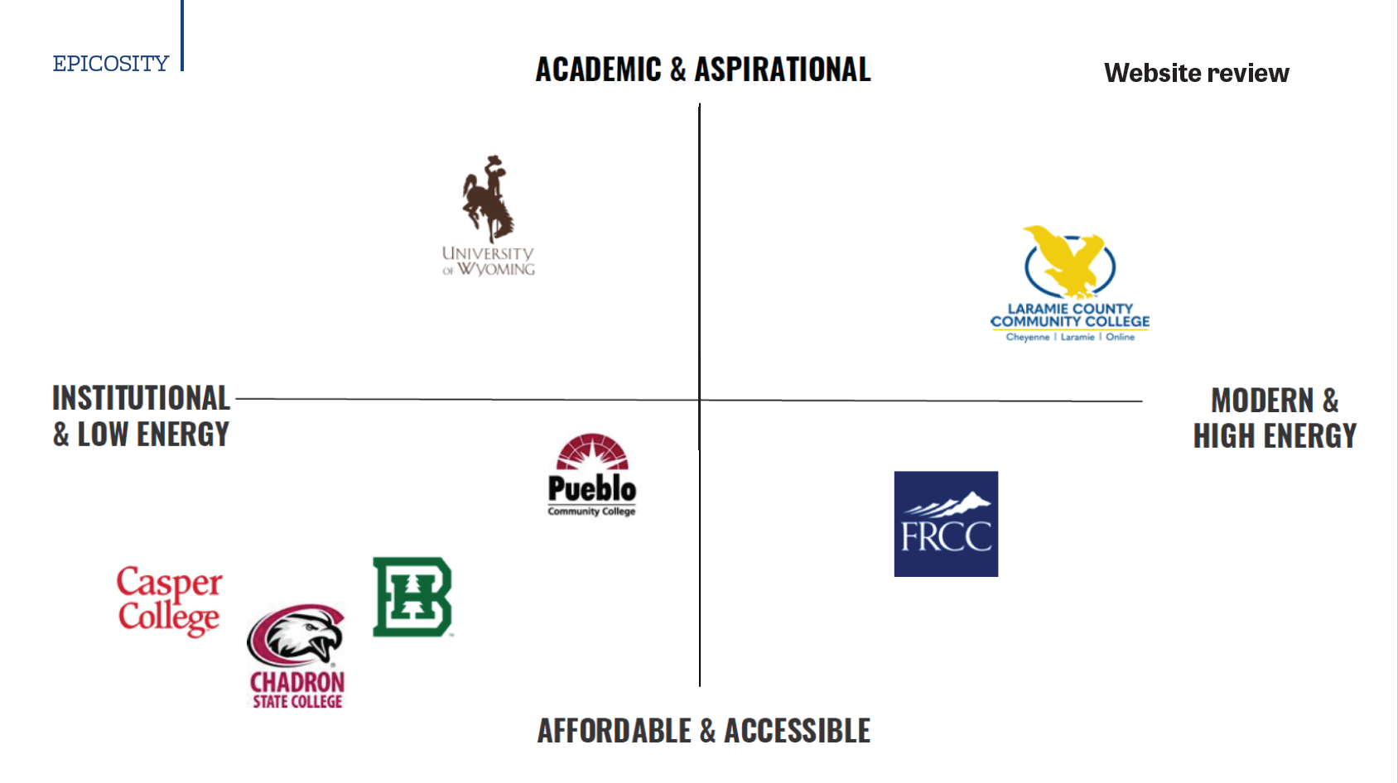
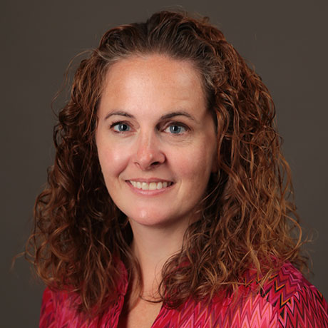
Laura Patridge
Web Content Specialist

Slide 66
Key insight
We’re not at a crisis point--but we may be at a turning point.
The research reveals no urgent need to change the name, but there is a clear opportunity to strengthen LCCC’s identity, brand and reach.

Slide 67
initial Findings
#1 - There is a Cliff of Awareness Outside of Laramie County
Key Take Away: While LCCC is well known by internal audiences and individuals from Laramie County, outside of that most people are unaware of the College, let alone what our brand promises.
#2 - The Current Name May Undercut LCCC’s Academic Strength
Key Take Away: “Laramie County Community College” may unintentionally suggest limited academic scope. A clearer, updated brand promise and name could reinforce LCCC’s rigor, comprehensive offerings, transfer pathways, and workforce outcomes.
#3 - LCCC’s Name Is Unfamiliar and Often Misunderstood
Key Take Away: LCCC’s name lacks clarity and recognition, especially outside Wyoming. Many either mistake its location or are unfamiliar with the college altogether -- particularly in Colorado, where misperceptions are most pronounced.

Slide 68
Initial Findings
#4 - The Name Isn’t Hurting, But It’s Not Helping
Key Take Away: Neutrality isn’t helping growth. Most respondents feel indifferent toward the name, but data shows clearer geographic and programmatic branding could boost appeal -- especially with out-of-state students.
#5 - A Clearer Name Could Strengthen Appeal and Recommendations
Key Take Away: The name works for insiders but limits growth beyond them. While local audiences are familiar, external audiences see the name as confusing, overly local, or lacking relevance. A clearer brand promise and name could expand reach, sharpen perception, and unlock new opportunity.

Slide 69
Regional Insights: Rename Sentiment Overview
Regional data shows broad neutrality toward the current name, but external audiences face higher confusion and lower awareness. A rename would most benefit out-of-state growth, while local messaging should emphasize continuity and legacy.
Region | Perception of Current Name | Appeal of Rename | Key Distinctions / Notes
Laramie County | High familiarity, strong local support. Less confusion. | Less urgency for change; 36% say name adds appeal. | Loyal base, pride in identity. Concerned about preserving legacy.
Wyoming (excluding Laramie County) | Moderate familiarity. Higher confusion than Laramie County. | More support for change (26% support rename). | Sees value in clarity and relevance; concerned name limits perception.
Denver Metro | 73% had never heard of LCCC. Only 7% knew it’s in Cheyenne. | High support for rename to clarify location and offerings. | Most confused region. Strongest case for change. Very low brand awareness.
Colorado (Not incl. Denver Metro) | 65% unaware of LCCC. Only 14% knew it’s in Cheyenne. | High openness to rename (35% favor changing name). | Similar to Denver in confusion. Wants clearer geographic alignment.
Nebraska | Very low awareness. Misunderstood location. | Rename could improve clarity and broaden reach. | Especially in Scottsbluff: 67% found name unappealing. High confusion.

Slide 70
in a Sea of Sameness
Laramie County Community College
Affordable, Community, Community College, Local, Cheaper, Small, Technical
Casper College
Affordable, Community, Local, Good, Great, Thunderbirds, Location, Small
Aims Community College
Affordable, Community, Small, Local, Near to Me
Front Range Community College
Affordable, Community College, Community, Local, Accessible, Near to Me
Wester Wyoming Community College
Community, Affordable, College, Convenient, Helpful

Slide 71
Two Things We must Address:
What is our Brand Promise – and Can we deliver on it?
How will we Differentiate Ourselves in a broader, Increasingly competitive Market?

Slide 72
Part of the Promise? – LCCC Experience
A Transformative Experience – personal, impactful, and empowering.
Have exceptional first impressions of the College.
Be part of a vibrant community, both on and off campus, where they feel they belong and are connected to others.
Be inspired early at LCCC to establish their educational and career goals.
Develop a plan that aligns with those goals.
Be actively engaged in the learning process.
Be transformed by doing something meaningful that applies learning inside LCCC to experiences beyond the classroom.
Be prepared and excited for what comes after LCCC, leading to a successful transition to their “next steps” in life.

Slide 73
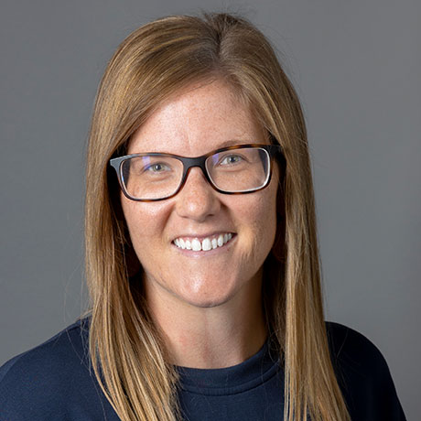
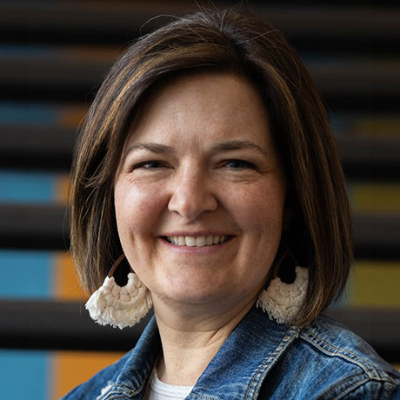


Shaping The Student Experience
Justine Essex
GEAR UP Manager
Jennie Hedrick
Student Services Manager,
Laramie Campus
Scott Van Horn
Trades & Technical Studies Pathway Coordinator
Dr. Ami Wangeline
Biology Faculty

Slide 74
Fighting the Headwinds

Slide 75
Internal Locus of Control:
Individuals with a strong internal locus of control believe their actions, decisions, and efforts directly impact their lives. They are more likely to take responsibility for their successes and failures, and they tend to be more proactive in pursuing goals and overcoming challenges.
External Locus of Control:
Individuals with a strong external locus of control tend to believe that external forces, such as luck, fate, or other people's actions, are the primary determinants of their lives. They may be more likely to attribute outcomes to chance or circumstances beyond their control.

Slide 76









Slide 77


